Slide 1
Agent-based intelligent sandbox design to deceive and analyze sophisticated malware
24-25J-025

Slide 2
Research Question
How can proactive detection methods be effectively implemented to identify malware within a sandbox environment?

Slide 3
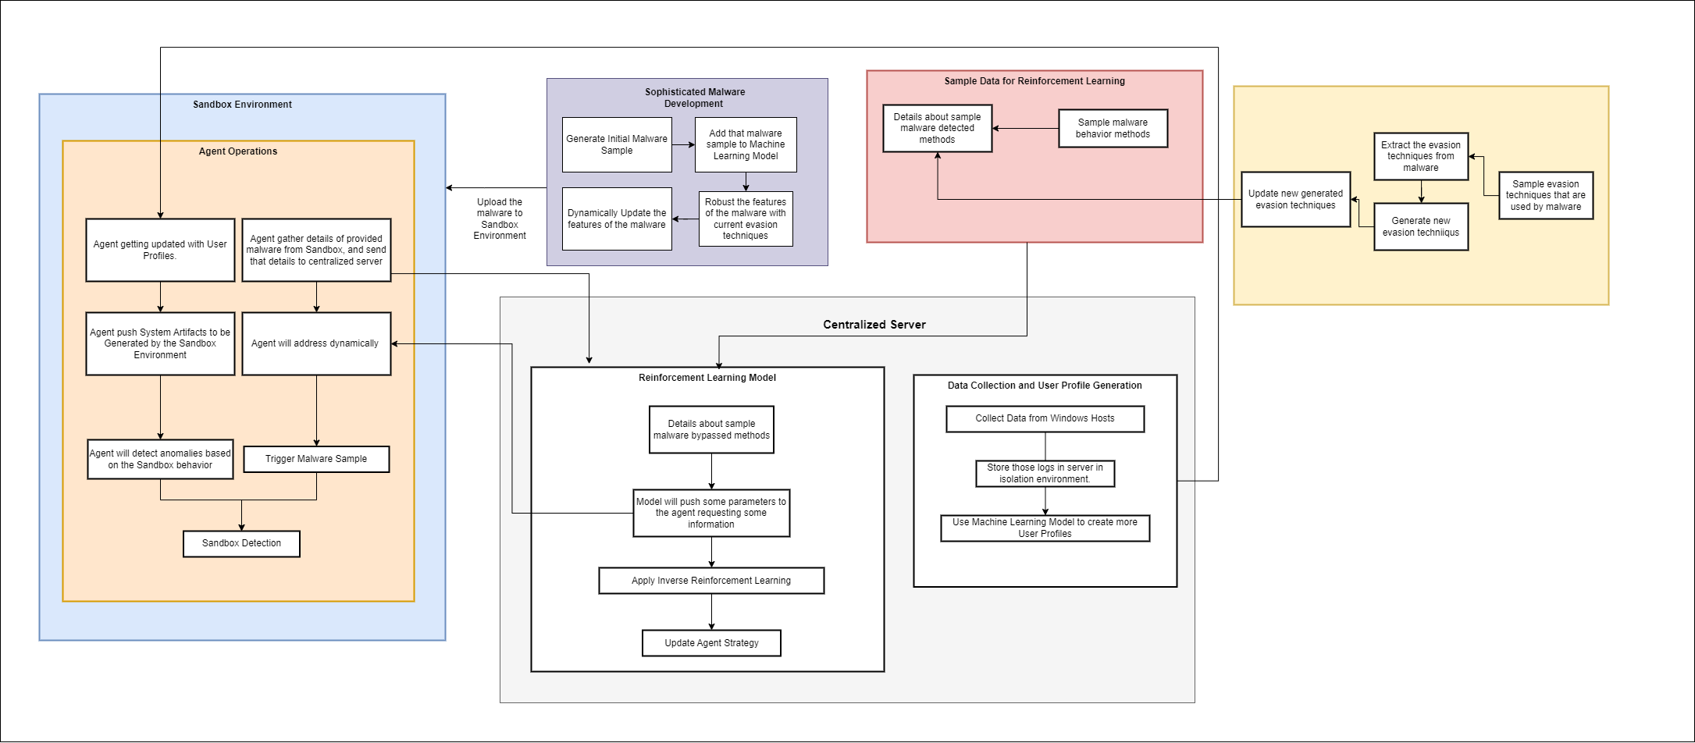
Overall System Diagram

Slide 4

IT21261046 | W.M.M.S.D.S. Perera
Cyber Security
IT21261046 | W.M.M.S.D.S. Perera | 24-25J-025

Slide 5
Research Gap
Research Problem
There is a lack of comprehensive studies focused on developing malware that can bypass advanced sandbox environments (like Cuckoo), especially using reinforcement learning (RL).
The specific issue is how to develop malware that can effectively evade detection by the
Cuckoo sandbox, utilizing RL to enhance the evasion capabilities dynamically.
Majority of this research, based on the defensive approach or proactive approach. But the offensive approach is also much needed for the take an good idea
about whole research area/domain.
IT21261046 | Perera WMMSDS | 24-25j-025

Slide 6
Sub Goals that Achieved
Develop the Infrastructure (Locally Installing Cuckoo Sandbox, Developed Malware Analysis Lab Environment -PMAT Flare VM)
Develop Custom Environment for the RL Agent and train the RL model for some degree.
Modified the sample Malware (Trojan and Ransomware) Evasion Techniques, so that it increase the Malware Evasion with cuckoo by 0 to 2 points in cuckoo ratings.
Partially Automated the Processes in that involved in the infrastructure.
IT21261046 | Perera WMMSDS | 24-25j-025

Slide 7
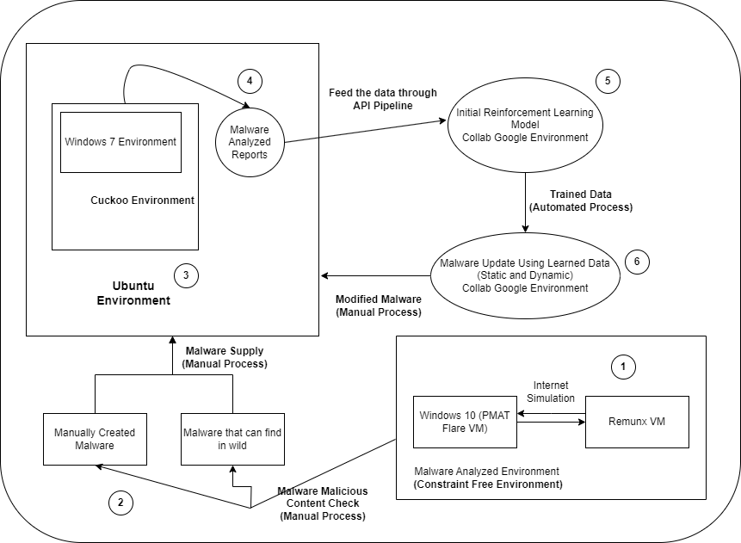
Infrastructure Setup
IT21261046 | Perera WMMSDS | 24-25j-025

Slide 8
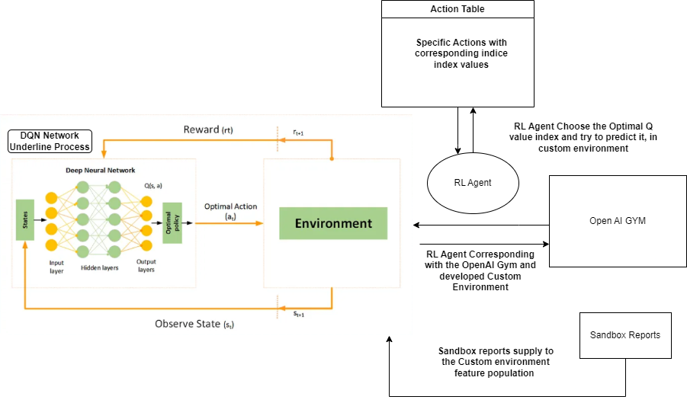
Reinforcement Learning Model Setup
Developing the Custom Environment
Training the RL agent with different states
IT21261046 | Perera WMMSDS | 24-25j-025 | Source - https://medium.com/@samina.amin/deep-q-learning-dqn-71c109586bae

Slide 9
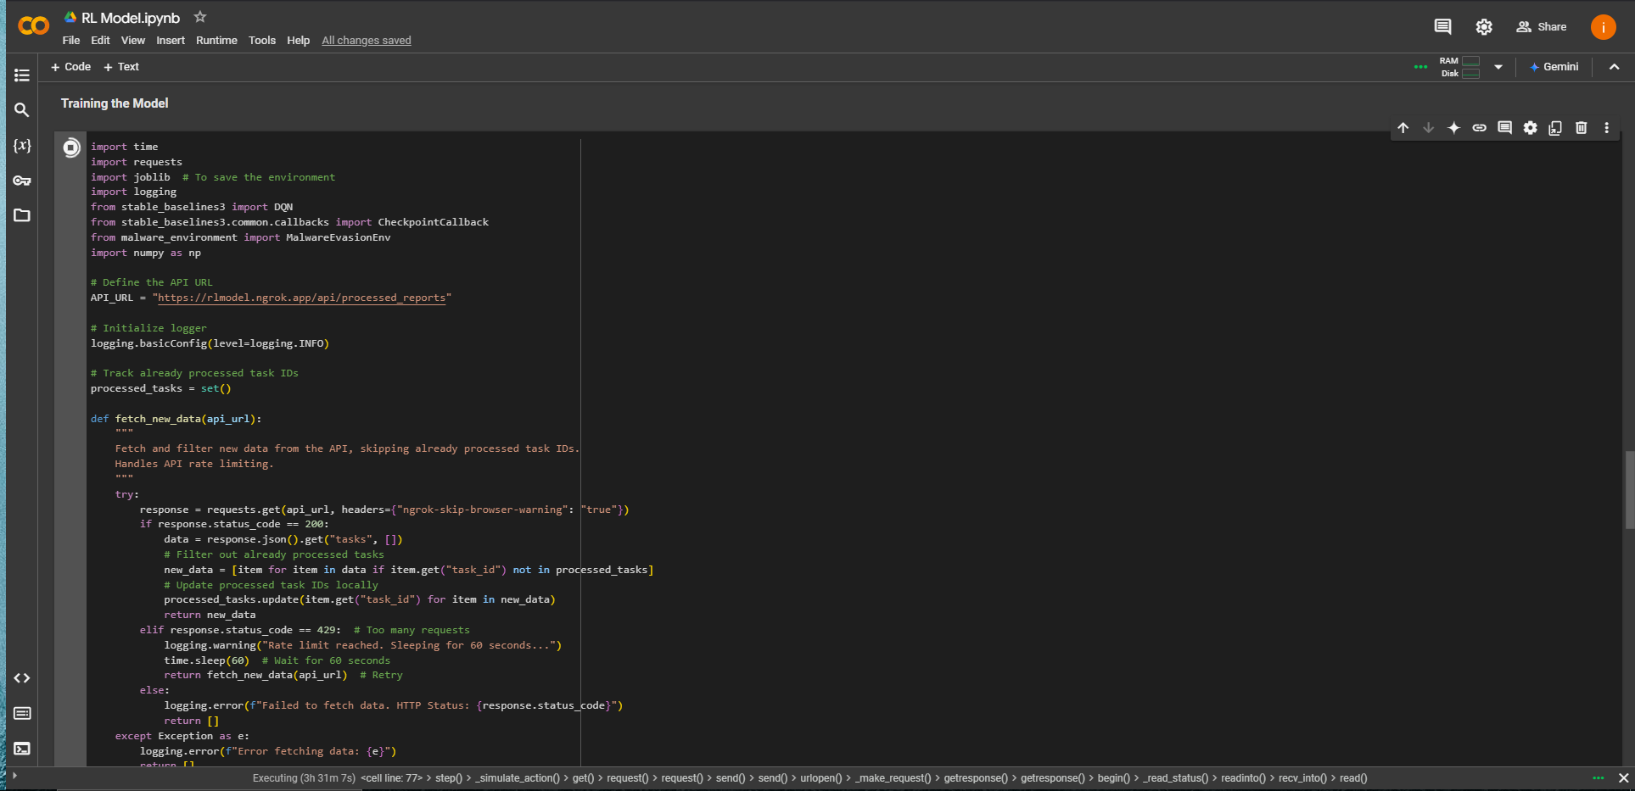
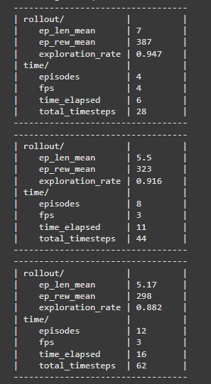
RL Model Training and Modifying the malware (Basic Training)
IT21261046 | Perera WMMSDS | 24-25j-025

Slide 10
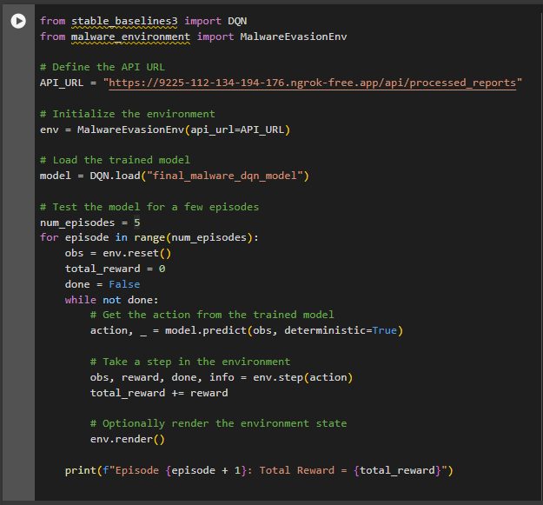
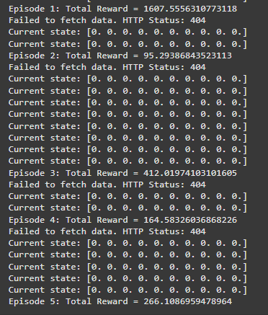
Cont. (For Each Episode Total Reward Calculation)
IT21261046 | Perera WMMSDS | 24-25j-025

Slide 11
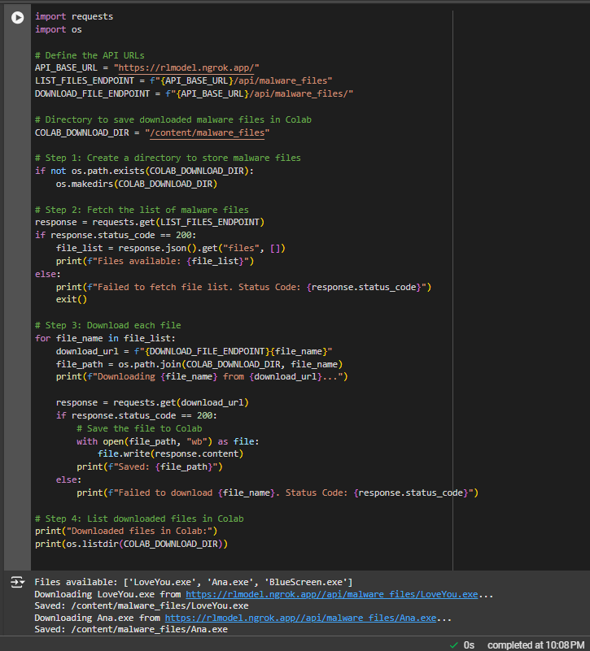
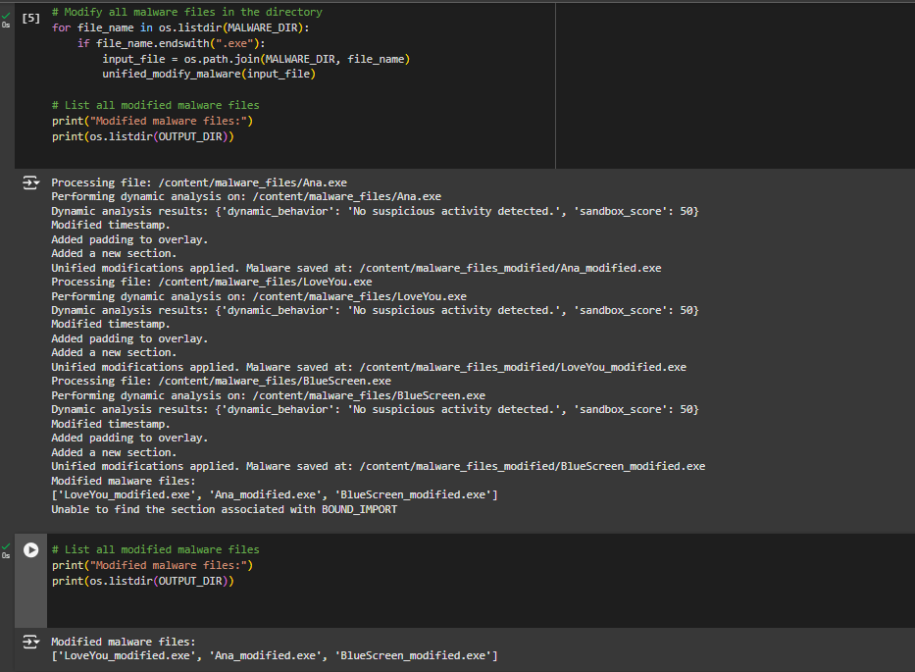
Malware Upload and Modification
IT21261046 | Perera WMMSDS | 24-25j-025

Slide 12
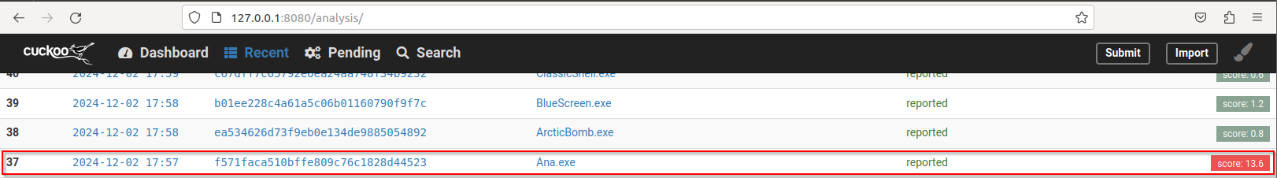
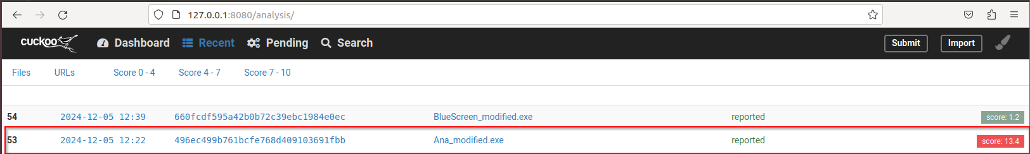
Modified Malware Cuckoo Evasion (One Successful Example)
IT21261046 | Perera WMMSDS | 24-25j-025

Slide 13
Next Step
Develop the Hybrid Environment with agent plant in the cuckoo sandbox (Still RL Agent working in custom development environment –OpenAI GYM).
Automate whole processes regarding the infrastructures.
Modified the sample Malware Evasion Techniques, so that it increase the Malware Evasion by higher cuckoo rating points (Best case scenario – Achieve full Evasion against Cuckoo)
Try to touch Malware Families other than Trojan and Ransomware
IT21261046 | Perera WMMSDS | 24-25j-025

Slide 14
References
[1] T. Quertier, B. Marais, S. Morucci, and B. Fournel, "MERLIN: Malware Evasion with Reinforcement Learning," arXiv preprint arXiv:2203.12980v4, Mar. 2022.
[2] W. Song, X. Li, S. Afroz, D. Garg, D. Kuznetsov, and H. Yin, "MAB-Malware: A Reinforcement Learning Framework for Attacking Static Malware Classifiers," arXiv preprint arXiv:2003.03100v3, Apr. 2021.
[3] X. Li and Q. Li, "An IRL-based malware adversarial generation method to evade anti-malware engines," Computers & Security, vol. 104, pp. 102118, 2021, doi:10.1016/j.cose.2020.102118.
[4] W. Song, X. Li, S. Afroz, D. Garg, D. Kuznetsov, and H. Yin, "MAB-Malware: A Reinforcement Learning Framework for Blackbox Generation of Adversarial Malware," in Proceedings of the 2022 ACM Asia Conference on Computer and Communications Security (ASIA CCS ’22), Nagasaki, Japan, 2022, pp. 990-1000, doi: 10.1145/3488932.3497768
[5] R. Labaca-Castro, S. Franz, and G. D. Rodosek, "AIMED-RL: Exploring Adversarial Malware Examples with Reinforcement Learning," in Proceedings of the 16th International Conference on Availability, Reliability and Security (ARES '21), Vienna, Austria, 2021, pp. 1-9, doi: 10.1145/3465481.3470076
IT21261664 | Dias M.A.S.S.A | 24-25J-025

Slide 15

IT21261664 | dias m.a.s.s.a
Cyber Security
IT21261664 | Dias M.A.S.S.A | 24-25J-025

Slide 16
Realistic User Behaviour Simulation to Counter Sandbox-Evasive Malware
How can realistic user behavior profiles with dynamic behaviour be generated, to enhance the user behaviour within the sandbox environment ?
IT21261664 | Dias M.A.S.S.A | 24-25J-025

Slide 17


Research Gap – From Lit Review
Research Paper | User Behaviour Simulation | Dynamic Data Utilization | Generative Model Usage | Realism of Simulated Behaviour
Enhancing malware analysis sandboxes with emulated user behavior (2022)
User behavior simulation with large language model based agents(2023)
Investigating anti-evasion malware triggers using automated sandbox reconfiguration techniques (2020)
Proposed Approach
IT21261664 | Dias M.A.S.S.A | 24-25J-025

Slide 18
Sub Goals Achieved
Defined the schema for initial user profile
Trained a GAN model to generate user profiles
Added dynamic browser related user interests to the user profile
Created the complete user profile with user behaviour characteristics
IT21261664 | Dias M.A.S.S.A | 24-25J-025

Slide 19
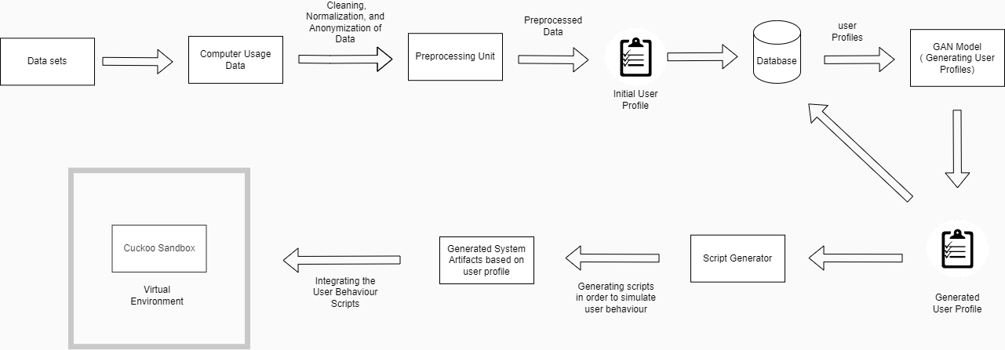
Methodology
IT21261664 | Dias M.A.S.S.A | 24-25J-025

Slide 20
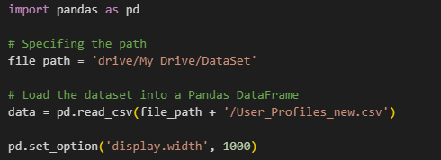
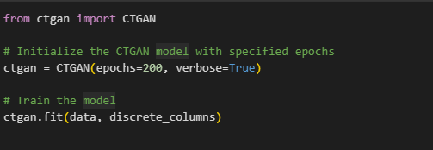
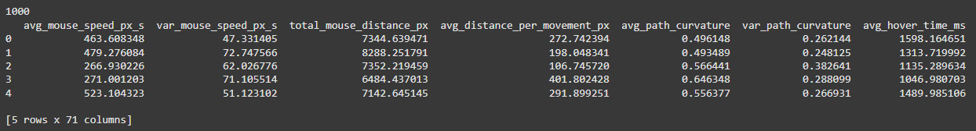
CTGAN Model Training
IT21261664 | Dias M.A.S.S.A | 24-25J-025

Slide 21
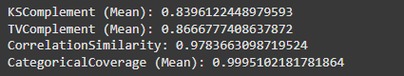
Evaluating the Generated Data
KSComplement (Mean) : - Similarity of continuous distributions.
TVComplement (Mean) : - Similarity of categorical distributions.
CorrelationSimilarity :- Similarity of pairwise correlations.
CategoricalCoverage (Mean) :- Shows generated data includes all the categories in the real data.
IT21261664 | Dias M.A.S.S.A | 24-25J-025

Slide 22
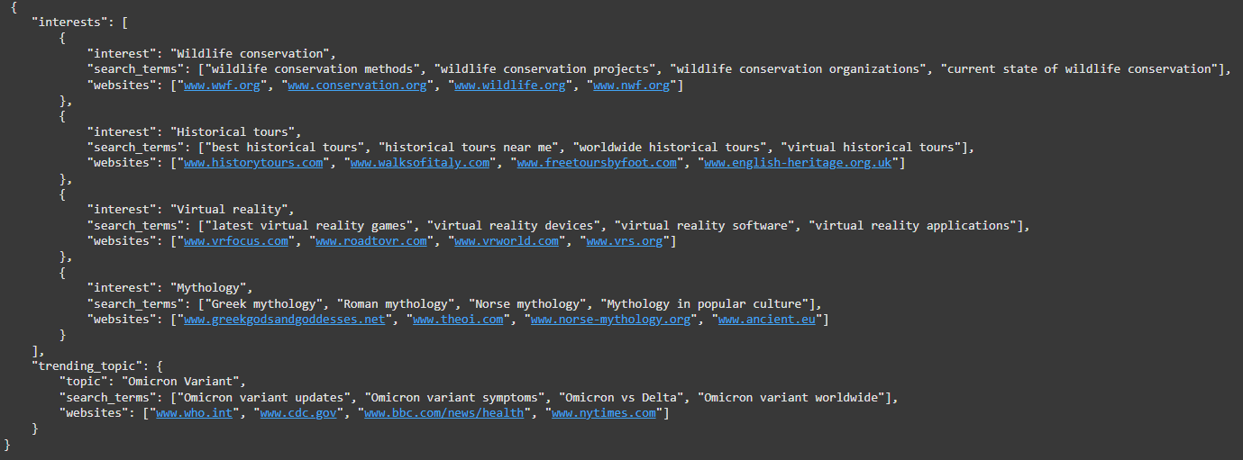
Generating Browser behaviour interests
Random selection of user interests from a set of interests.
Generating search terms & websites based on interests.
Extracting the search terms & websites
IT21261664 | Dias M.A.S.S.A | 24-25J-025

Slide 23
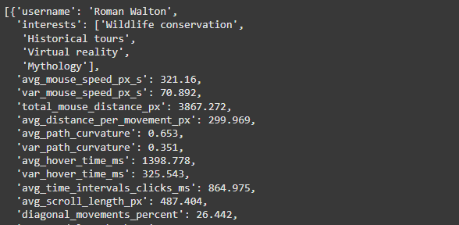
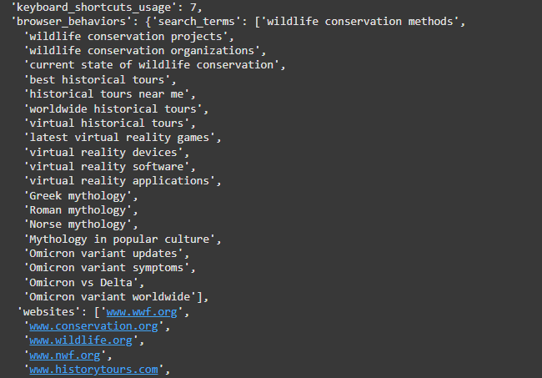
Completed User Profile
IT21261664 | Dias M.A.S.S.A | 24-25J-025

Slide 24
Next Steps
Automating the script generation process based on the user profile.
Integrating the generated scripts within the sandbox environment.
Simulating the user behaviour within the sandbox environment.
IT21261664 | Dias M.A.S.S.A | 24-25J-025

Slide 25
References
[1] S. Liu, P. Feng, S. Wang, K. Sun, and J. Cao, “Enhancing malware analysis sandboxes with emulated user behavior,” Comput. Secur., vol. 115, no. 102613, p. 102613, 2022.
[2] C. Xie et al., “EnvFaker: A method to reinforce Linux sandbox based on tracer, filter and emulator against environmental-sensitive malware,” in _2021 IEEE 20th International Conference on Trust, Security and Privacy in Computing and Communications (TrustCom), 2021.
[3] L. Wang et al., “User behavior simulation with large language model based agents,” arXiv [cs.IR], 2023.
[4] A. Dunmore, J. Jang-Jaccard, F. Sabrina, and J. Kwak, “Generative Adversarial Networks for malware detection: A survey,” arXiv [cs.CR], 2023.
[5] A. Mills and P. Legg, “Investigating anti-evasion malware triggers using automated sandbox reconfiguration techniques,” J. Cybersecur. Priv., vol. 1, no. 1, pp. 19–39, 2020.
IT21261664 | Dias M.A.S.S.A | 24-25J-025

Slide 26

IT21299452 | Dilhara W. M. A.
Cyber Security
IT21299452 | Dilhara W. M. A. | 24-25J-025

Slide 27
Developing a Generative Model to Analyze and Detect Sandbox Evasion Techniques Employed by Malware and Generate Potential Evasion Strategies
malware developers do not want their malware to be analyzed in isolated environments. Therefore, they design their code to detect virtual machine and sandbox environments and avoid executing malicious behavior while running in these isolated environments.
Agent Tesla remote access trojan (RAT) shuts down if it detects a sandbox environment as an example of malware sandbox evasion [1].
Malware authors are no stranger to code-reuse and cut&paste approaches[2].
IT21299452 | Dilhara W. M. A. | 24-25J-025
Notes:
My component focusing on "Developing a Generative Model to Analyze and Detect Sandbox Evasion Techniques Employed by Malware." This project represents an intersection of cybersecurity and machine learning, where we aim to enhance malware detection methods.
Malware developers are increasingly designing their malicious software to detect when it's running in a sandbox or virtual machine environment—places where we typically analyze malware. This detection allows them to avoid executing their malicious payload, which makes traditional analysis methods less effective.
For example, the Agent Tesla remote access trojan (RAT) is known to shut down if it detects a sandbox environment. Such evasion techniques pose a significant challenge to cybersecurity professionals who rely on sandboxing as a key defense mechanism.
Also most of those who create malware frequently use existing pieces of code from other malware or sources rather than writing new code from scratch
So In this project, I aim to address this challenge of sandbox evasion and advantage of code reuse

Slide 28
Research Question
Primary issue - Existing products and services in the malware detection domain focus primarily on identifying known threats and previously observed evasion tactics.
Problem Statement: How can a VAE-based generative model be utilized to both detect and generate sandbox evasion techniques employed by malware ?
Existing challenges:
Limited datasets of evasion behaviors.
Detection models not adaptive to novel evasion techniques.
IT21299452 | Dilhara W. M. A. | 24-25J-025
Notes:
Given this context, the core question driving my research is: "How can a VAE-based generative model be utilized to both detect and generate sandbox evasion techniques employed by malware?”
This question underpins the innovative approach of my project, focusing on not just detection but also the proactive generation of potential evasion strategies.

Slide 29


Research Gap
Research | Analyze & Detect Malware evasion techniques | Integrate with a sandbox for analyze | Comparative detection | Generating potential evasion techniques
M. Ficco, "Malware Analysis by Combining Multiple Detectors and Observation Windows," June 2022 [3].
"Comparative Study of Detection and Analysis of Different Malware with the Help of Different Algorithm,2023”[4].
"On the Effectiveness of Perturbations in Generating Evasive Malware Variants, 2023”[5].
Proposed Approach
IT21299452 | Dilhara W. M. A. | 24-25J-025
Notes:
Most existing systems focus on identifying known evasion techniques only after they've been deployed in the wild. This leaves a significant gap on malware detection
As the draft shows some of these recent research are able to detect malware evasion but not in a proactive manner ,
Some are analyzing without integrating with a sandbox so their analyses are heavly limited in a dyanamic level
And our proposed approach will brige those gaps by covering all these areas

Slide 30
Specific and Sub Objectives
Specific Objective
Develop a VAE-based generative model to analyze and detect sandbox evasion techniques employed by malware and simulate potential evasion strategies.
Sub Objectives
Data Collection and Preprocessing
Gather and preprocess a comprehensive dataset of known sandbox evasion techniques and malware behavior patterns.
Model Development
Design and train a VAE model to
Detection: Utilize the VAE to detect high reconstruction errors indicative of the evasion techniques.
Generation: Sample from the latent space to simulate potential evasion techniques.
Evaluation : Assess the model's performance using detection accuracy and generation quality
IT21299452 | Dilhara W. M. A. | 24-25J-025
Notes:
To tackle this challenge, I’ve outlined several sub objectives based on the main:
So as the specific aobjective I aim to develop a VAE-based generative model that can analyze and detect sandbox evasion techniques. And generate potential evasion strategies
And to brake down this
,First I will collect and preprocess a comprehensive dataset of known sandbox evasion techniques and malware behavior patterns.
Next, I will design and train the VAE model to detect high reconstruction errors indicative of the evasion technique of a malware sample
Then I will Sample from the latent space to generate new, potential evasion techniques
Finally, I’ll evaluate the model’s performance in terms of detection accuracy and generation quality.

Slide 31
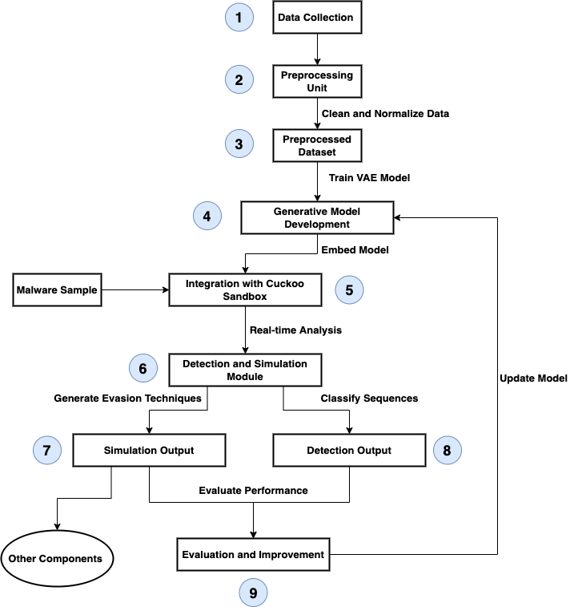
System Diagram
IT21299452 | Dilhara W. M. A. | 24-25J-025
Notes:
Here’s a high-level overview of the system architecture. At the heart of the system is the VAE model, which integrates with a sandbox environment like Cuckoo Sandbox.
The data collected by the system
Dynamic malware analysis consists of running a suspicious application inside a controlled and instrumented environment to observe and collect different aspects of the program behavior. The data collected by the system can then be used to look for evidence of malicious behavior, extract artifacts and indicators of compromise, or classify the sample in a particular class or malware family.

Slide 32
Current Progress
Implemented sandbox report parsing to extract API sequences.
Trained a VAE model to classify API sequences as benign or malicious.
Developed a rule-based detection system to identify evasion techniques from API sequences.
Integrated the evasion dataset for technique matching.
IT21299452 | Dilhara W. M. A. | 24-25J-025

Slide 33
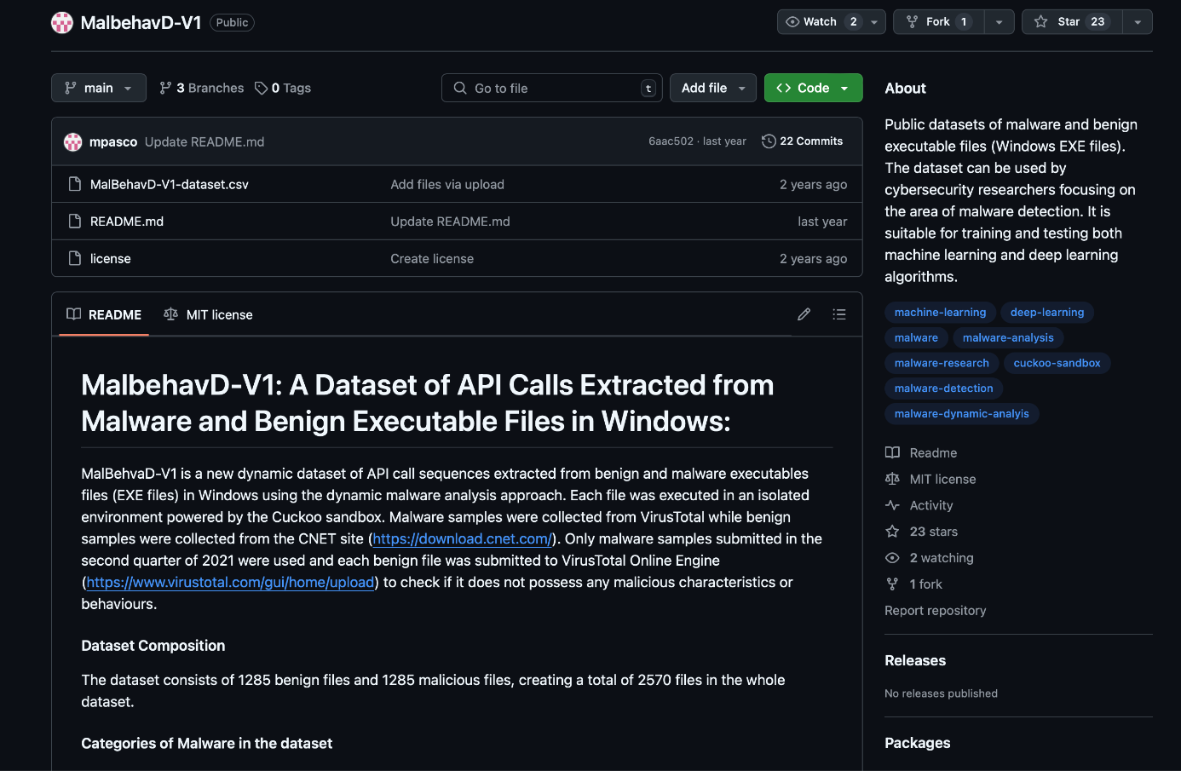
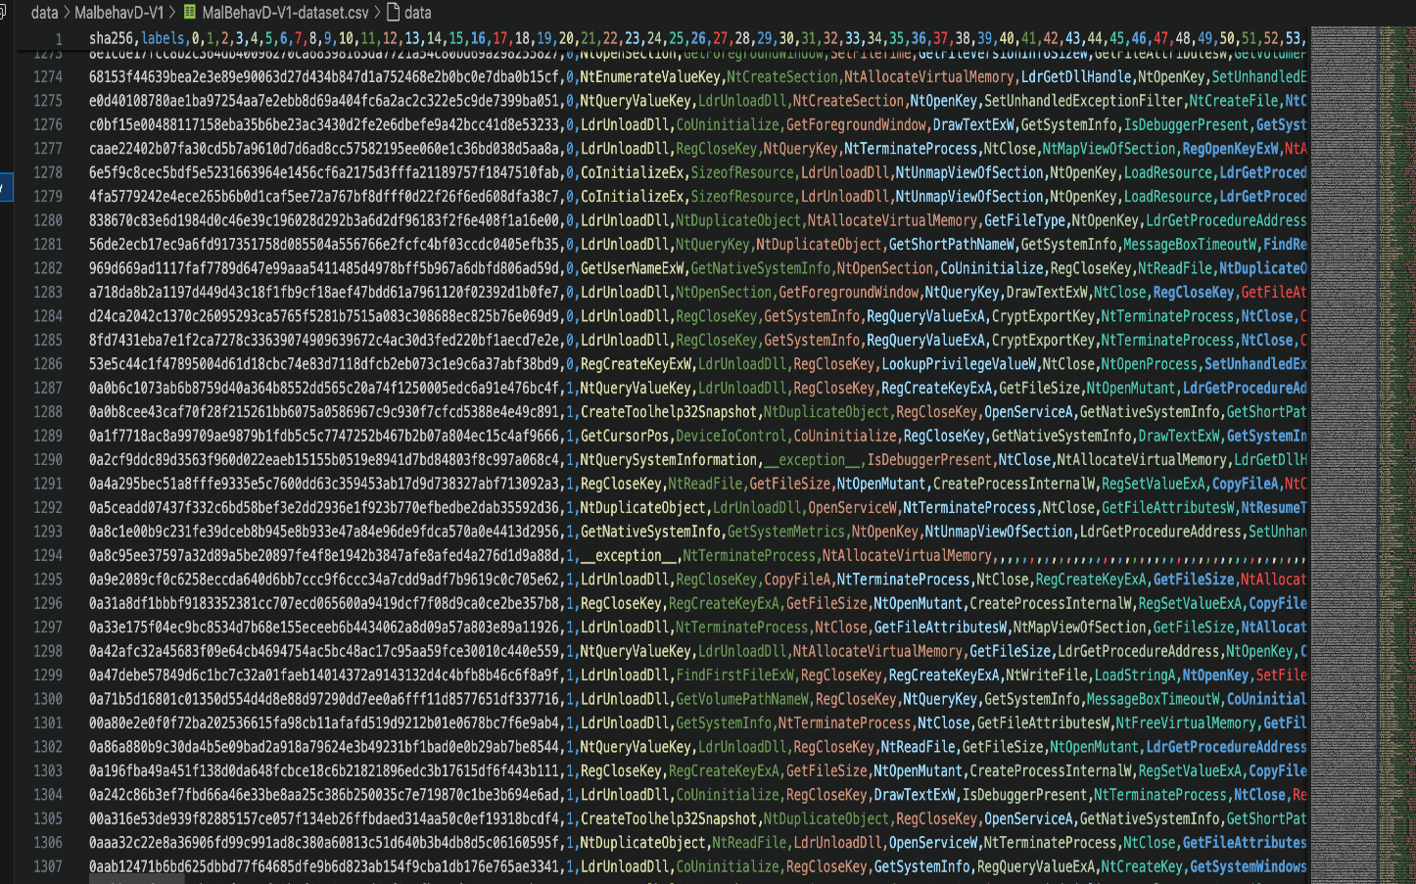
Data Collection
IT21299452 | Dilhara W. M. A. | 24-25J-025

Slide 34
Why Only API Sequences
The dataset primarily holds API sequences, making them the central feature for analysis.
API calls are a direct representation of system-level behaviors, which are critical for identifying sandbox evasion techniques.
Simplifies the scope and allows targeted analysis of malicious behaviors.
IT21299452 | Dilhara W. M. A. | 24-25J-025

Slide 35
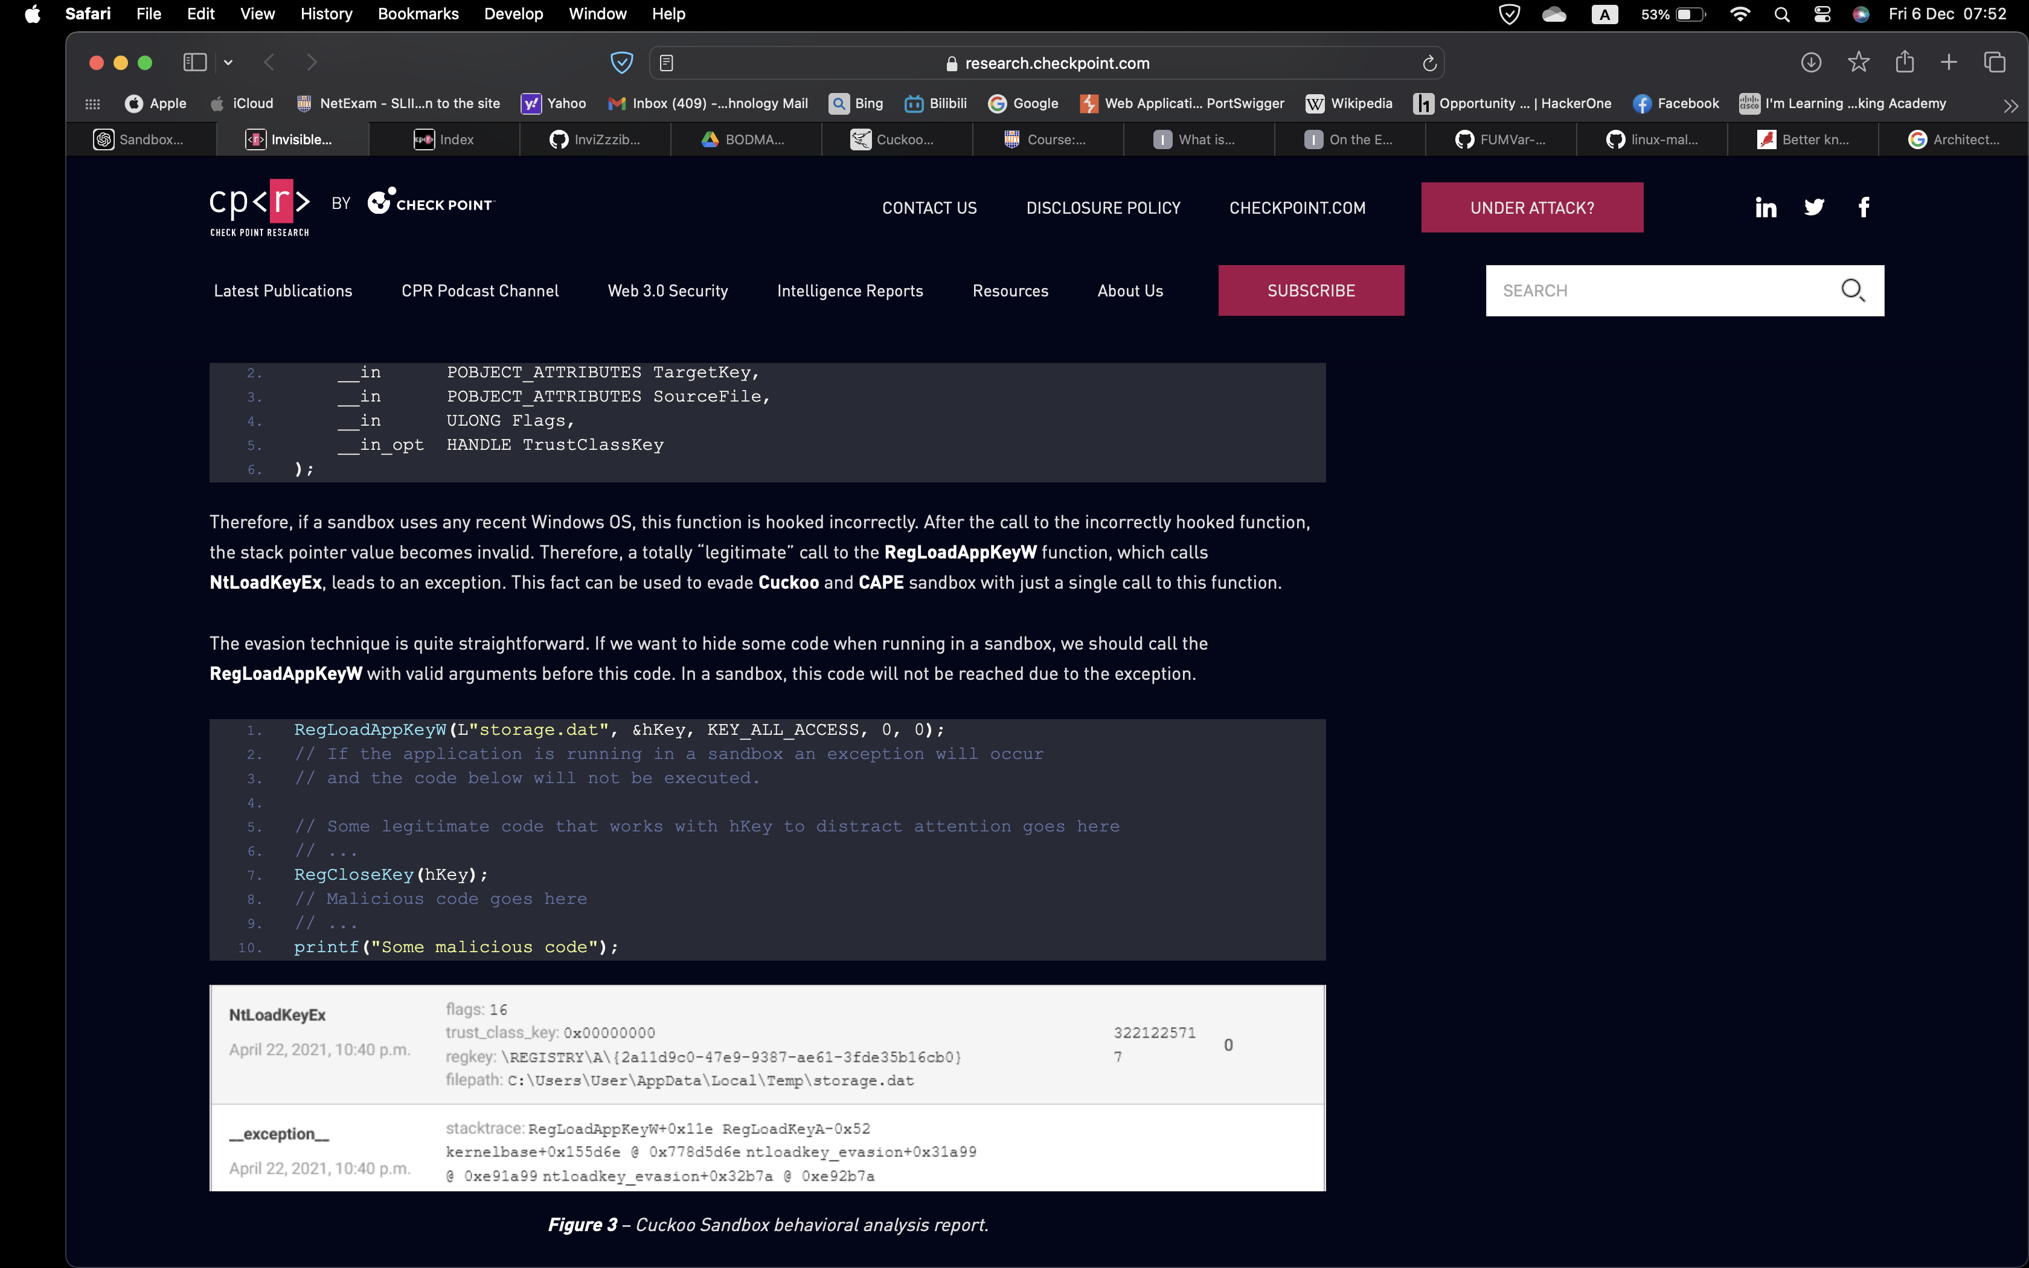
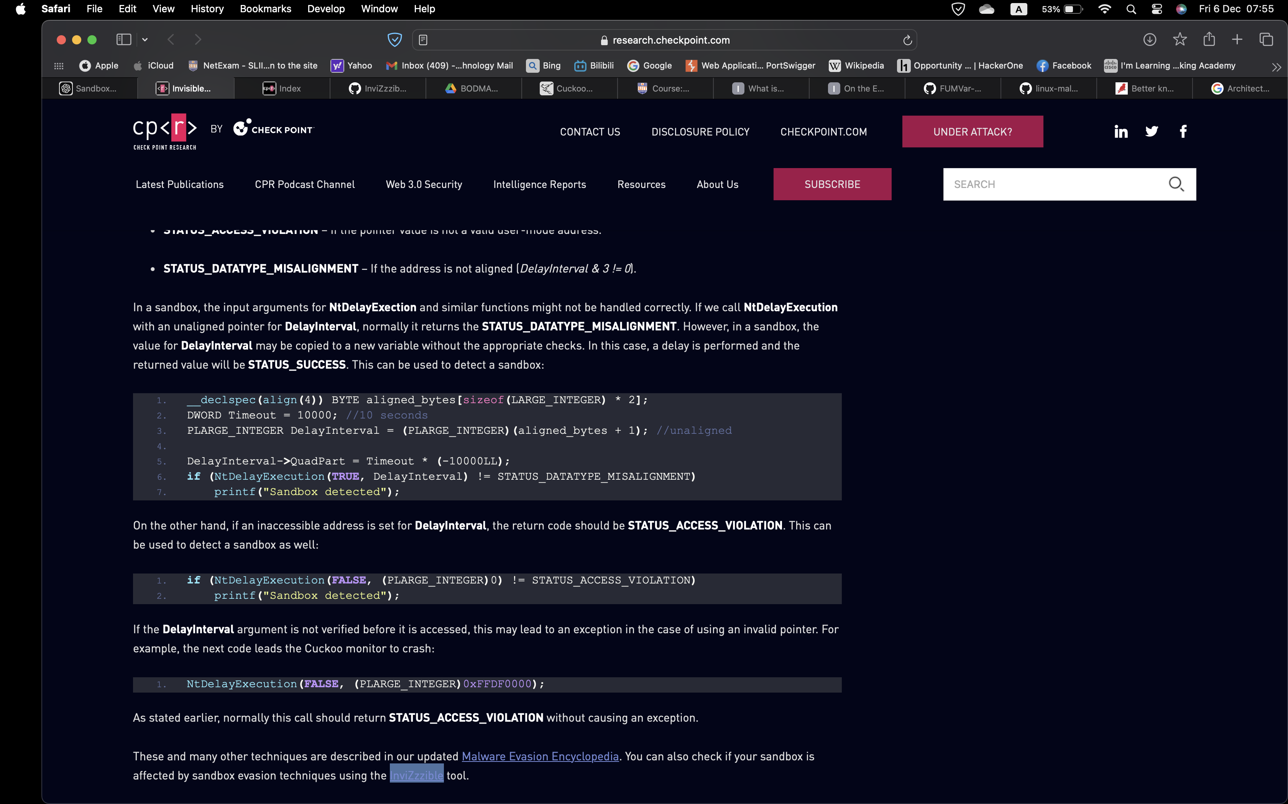
IT21299452 | Dilhara W. M. A. | 24-25J-025

Slide 36
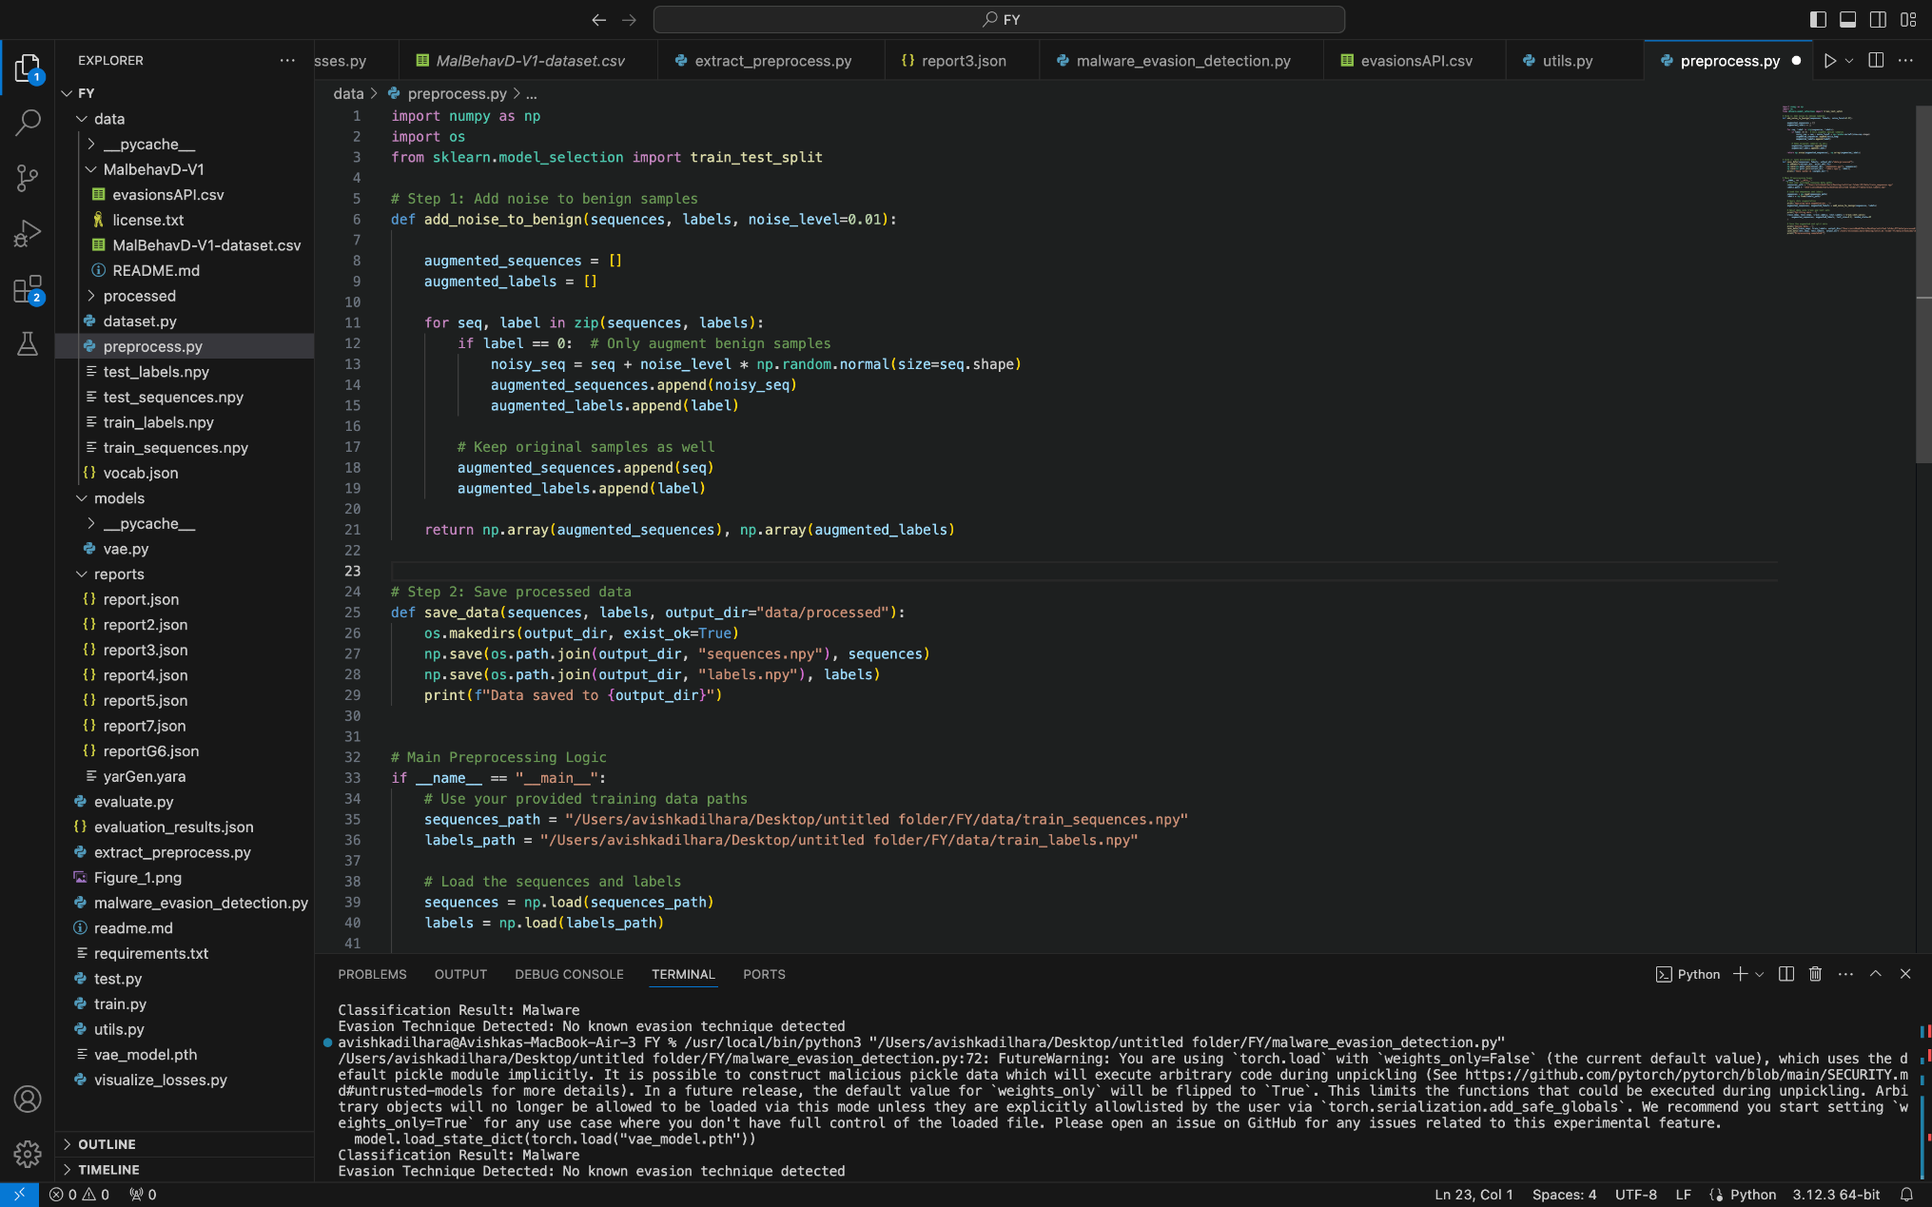
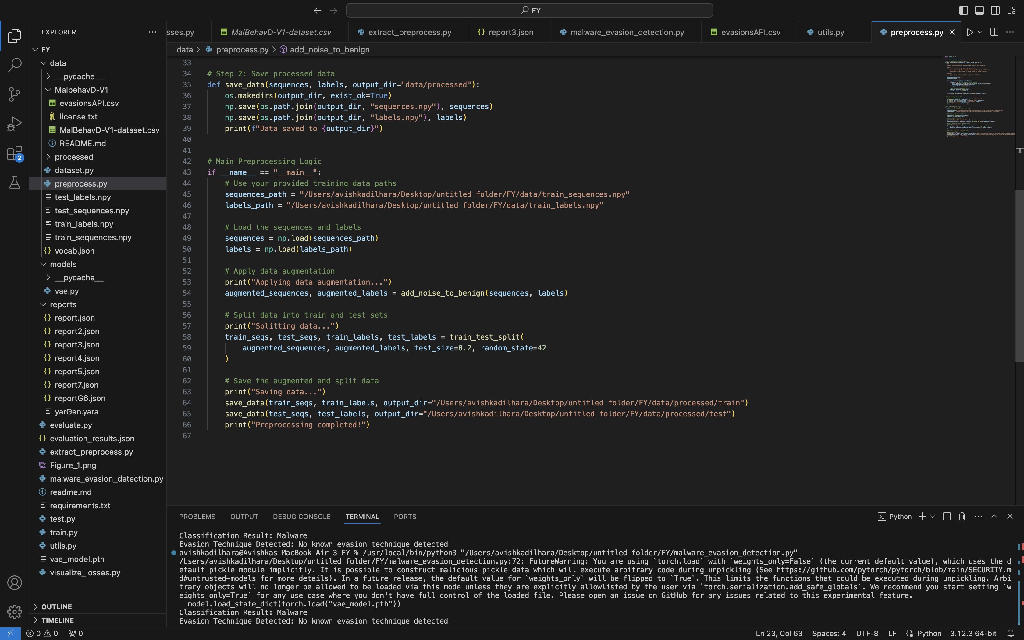
Preprocessing and Preprocessed Dataset
IT21299452 | Dilhara W. M. A. | 24-25J-025

Slide 37
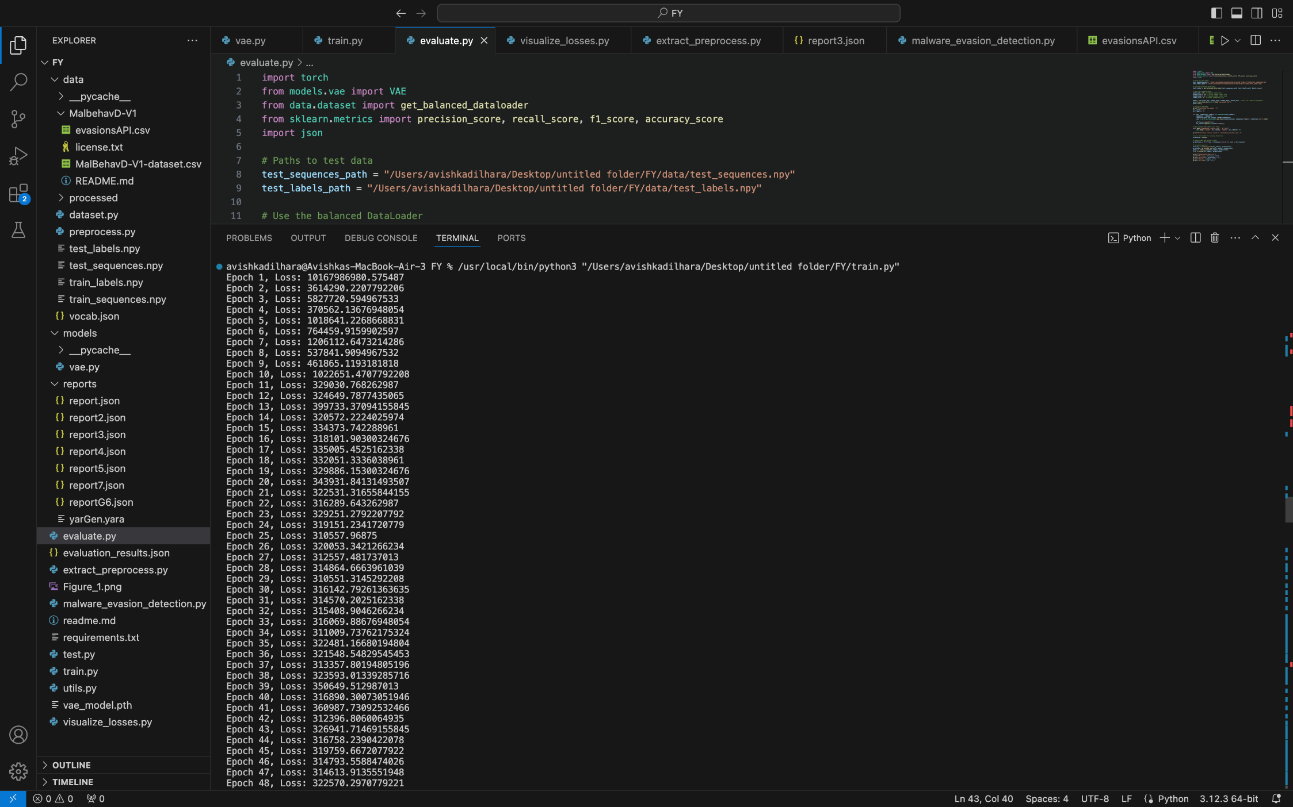
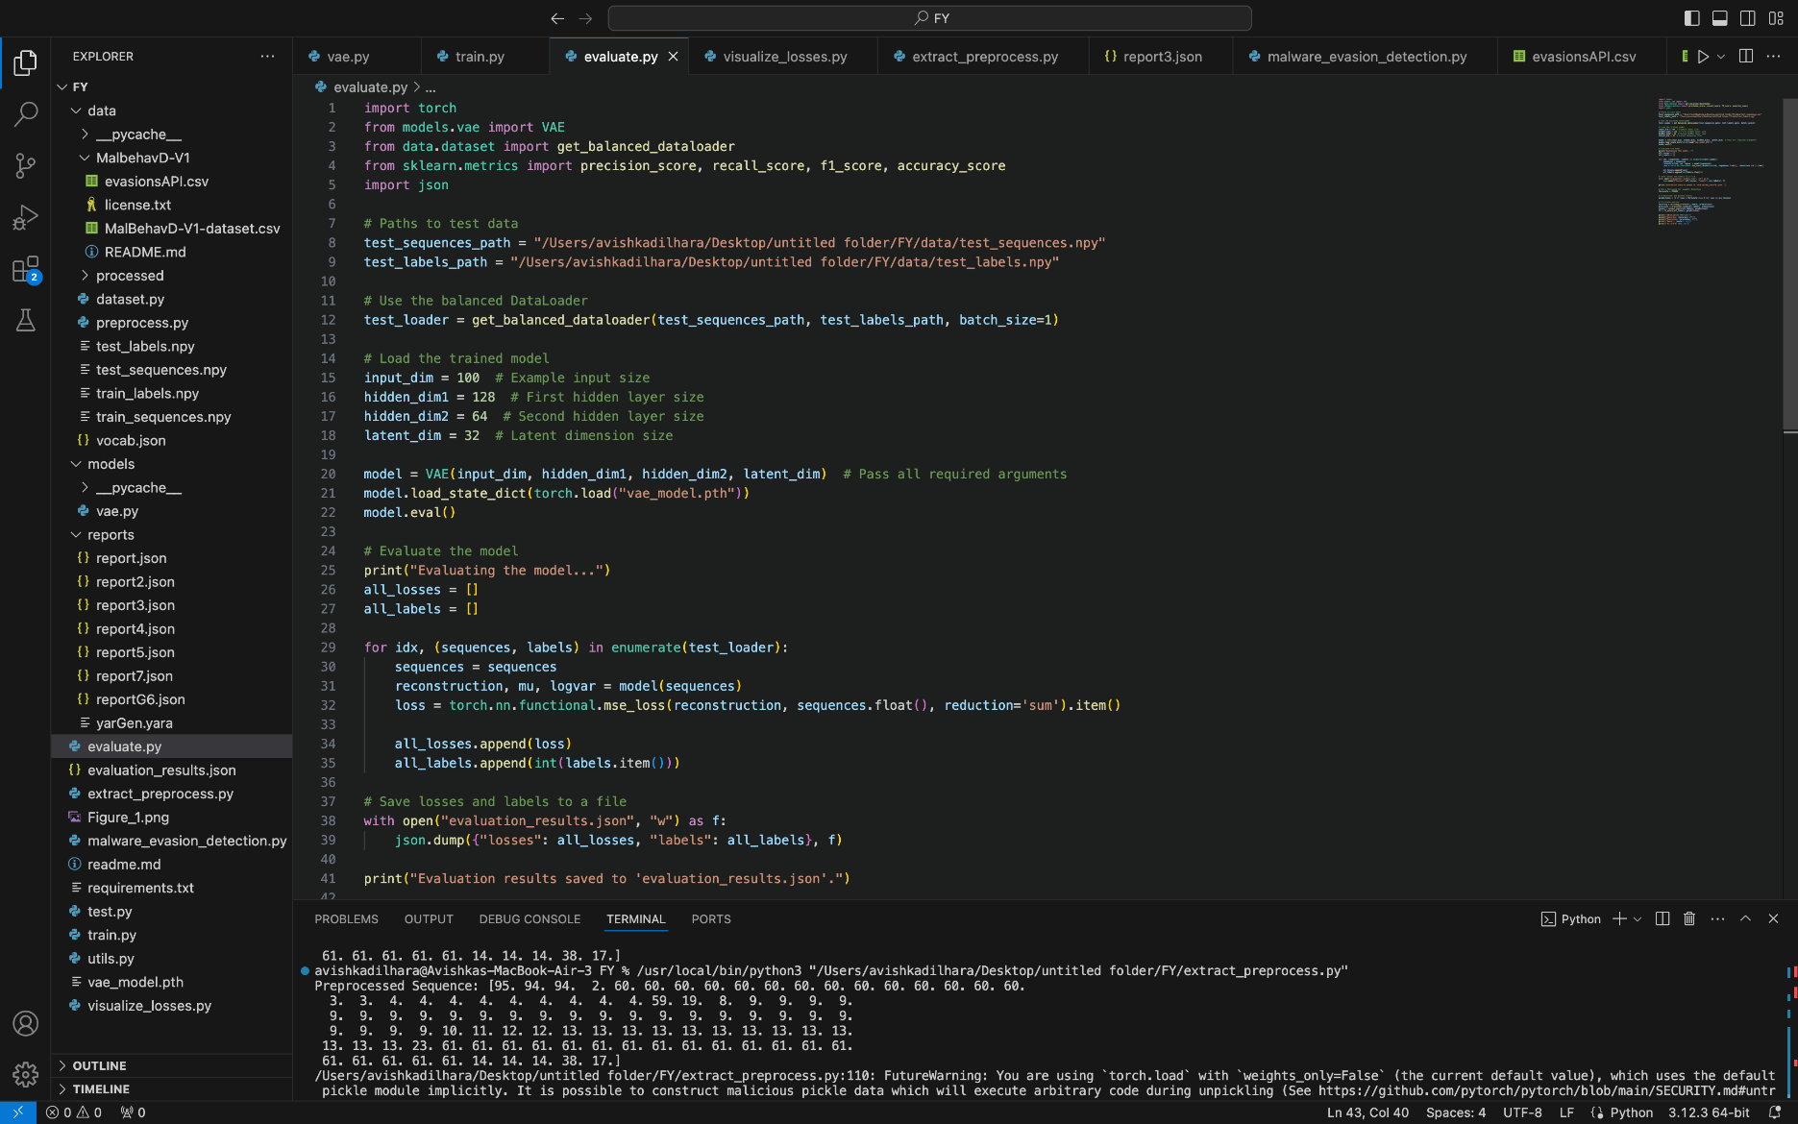
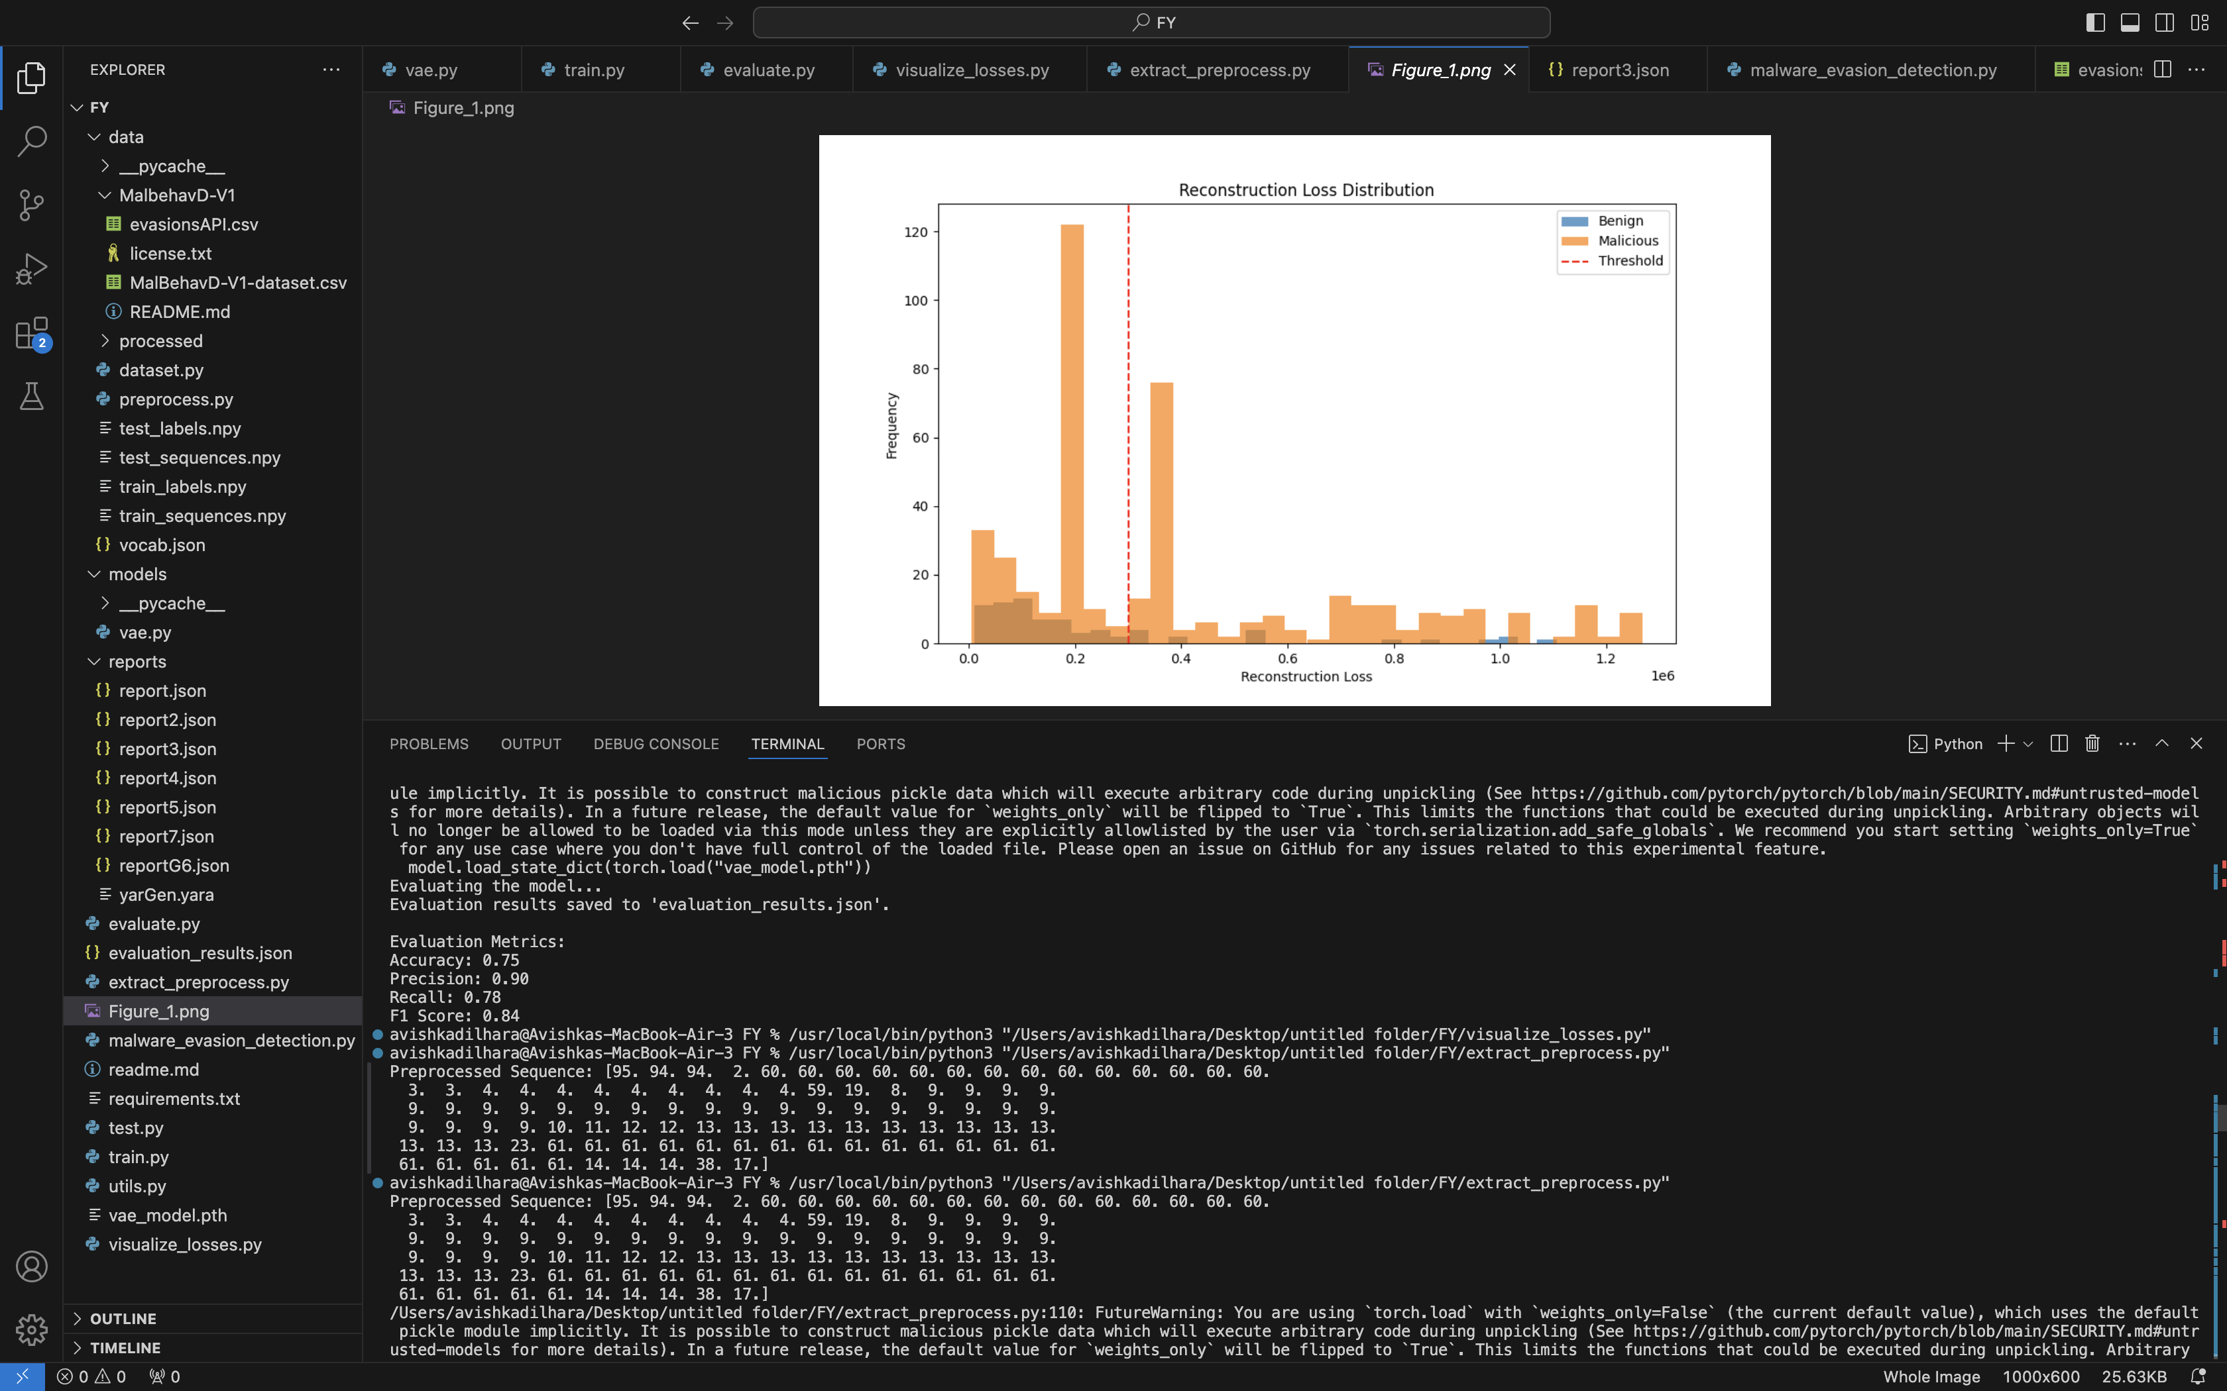
VAE Model Development
Build a Variational Autoencoder (VAE) to classify API sequences as benign or malicious.
IT21299452 | Dilhara W. M. A. | 24-25J-025
Notes:
Accuracy: 0.75 (75%)
Definition: The proportion of correctly classified samples (both benign and malicious) out of the total samples.
Precision: 0.90 (90%)
Definition: The proportion of sequences classified as malicious (or evasive) that are actually malicious.
Recall: 0.78 (78%)
Definition: The proportion of actual malicious sequences that the model correctly identified.
Recall: 0.78 (78%)
Definition: The proportion of actual malicious sequences that the model correctly identified.

Slide 38
Malware and Sandbox Evasion Detection
Extracting API Sequences from Sandbox Reports
Tokenizing and Preprocessing API Sequences
Using VAE Model for Classification
Rule-Based Detection of Evasion Techniques
IT21299452 | Dilhara W. M. A. | 24-25J-025

Slide 39
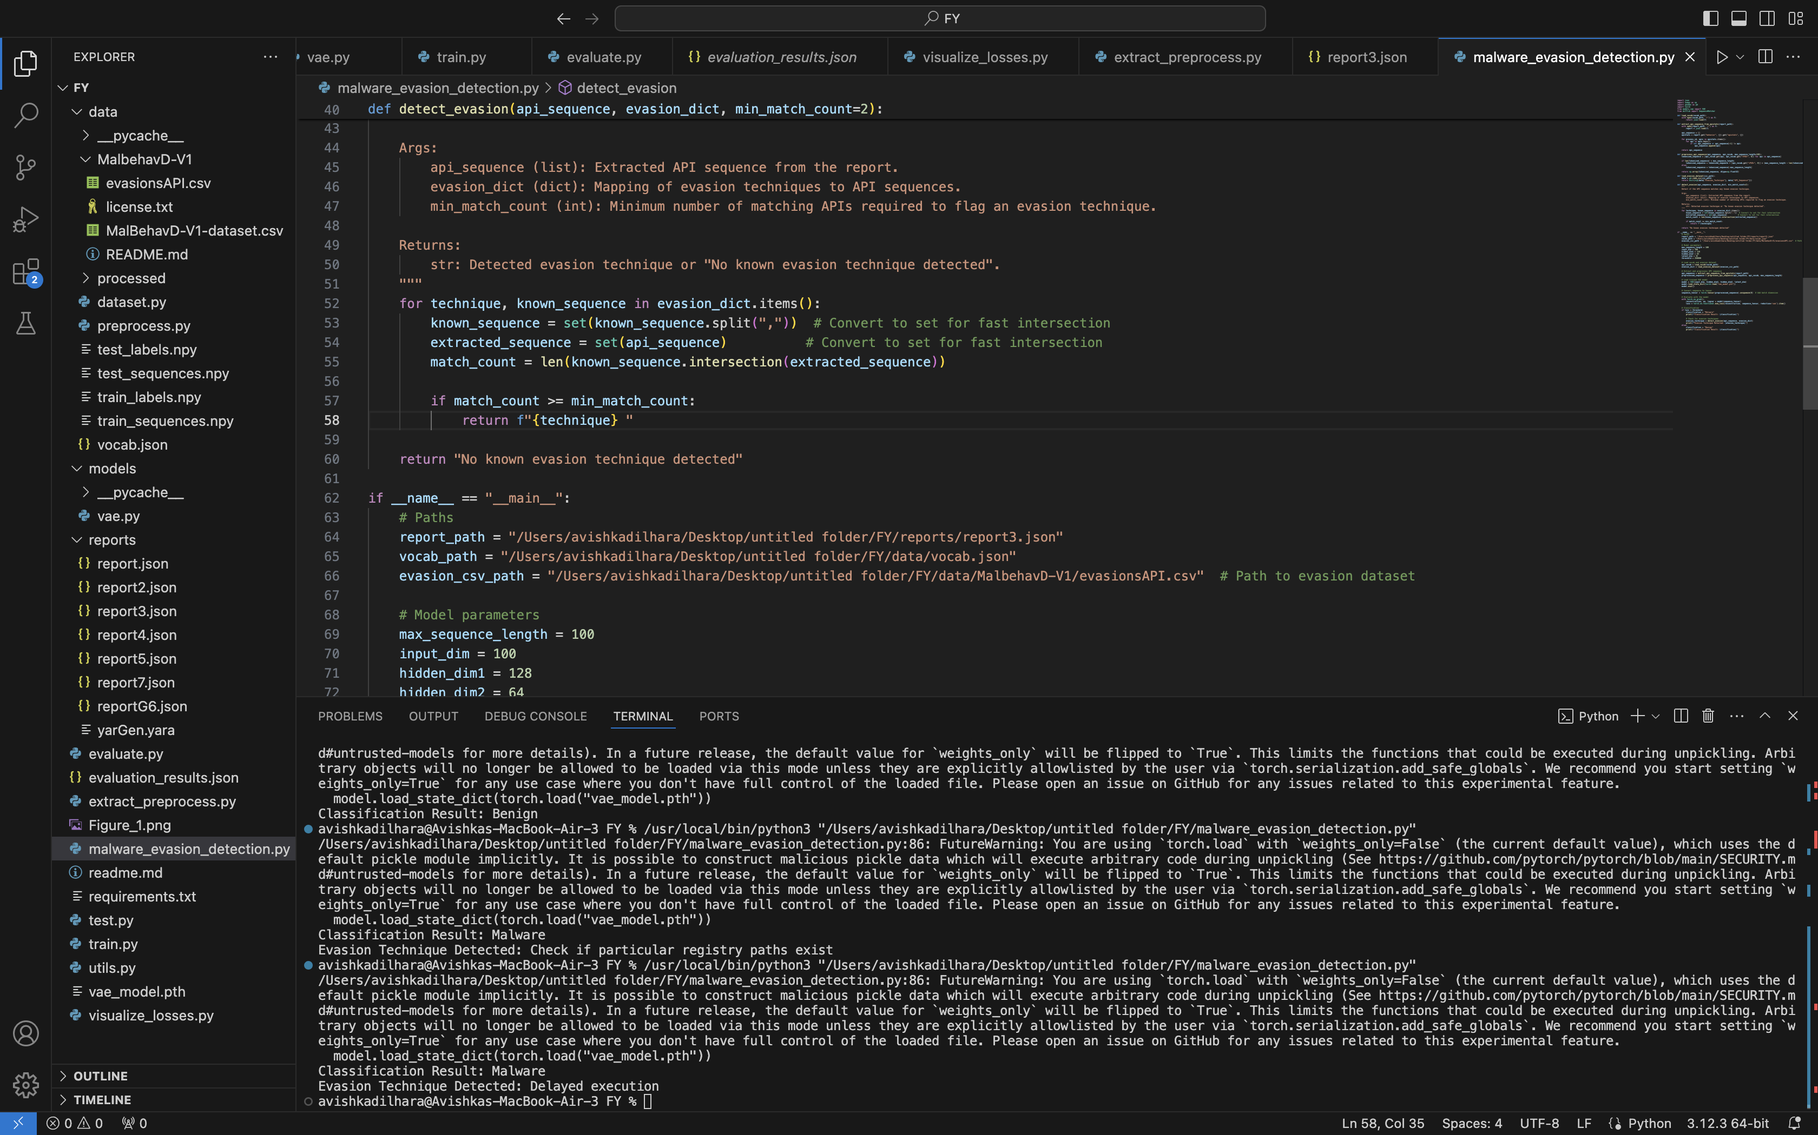
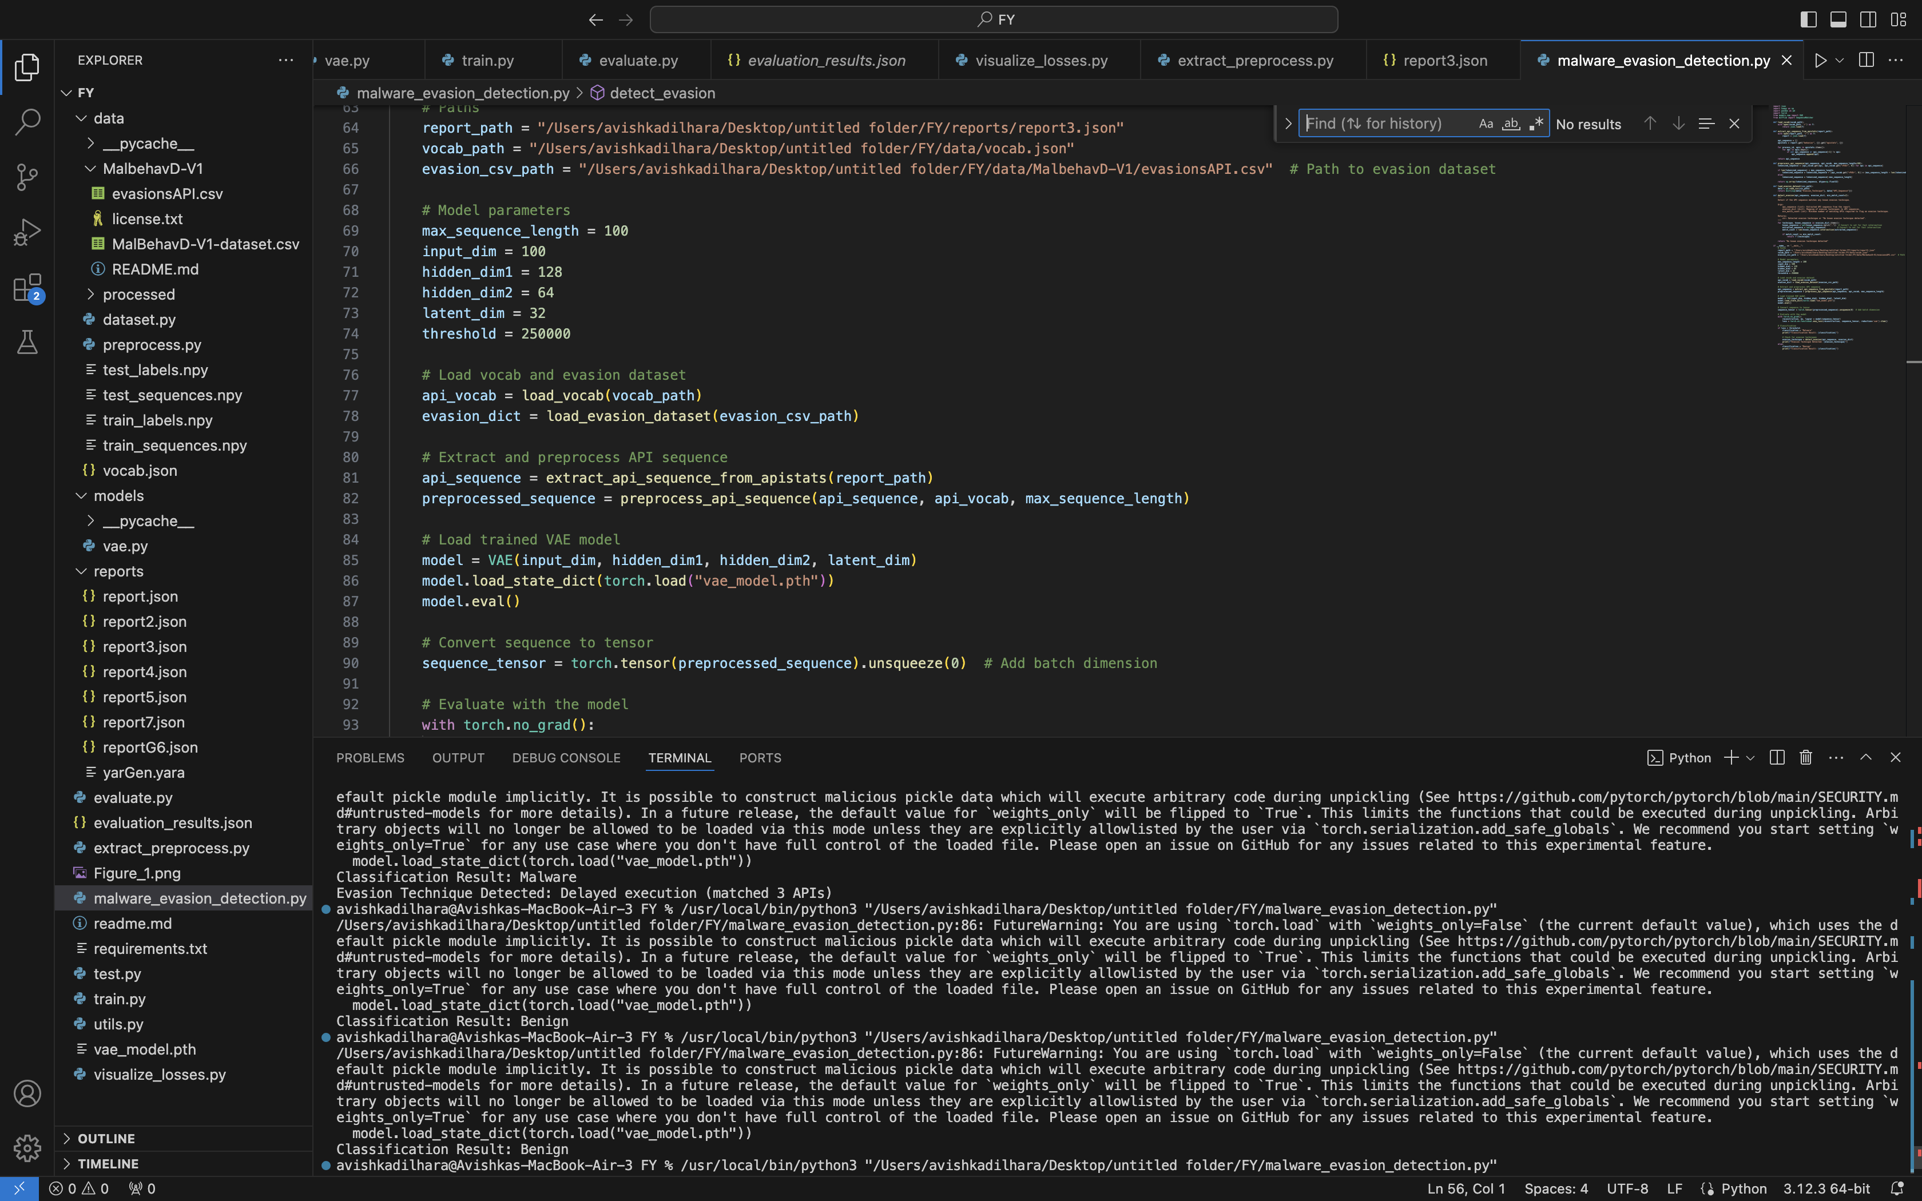
Example Workflow Execution
IT21299452 | Dilhara W. M. A. | 24-25J-025

Slide 40
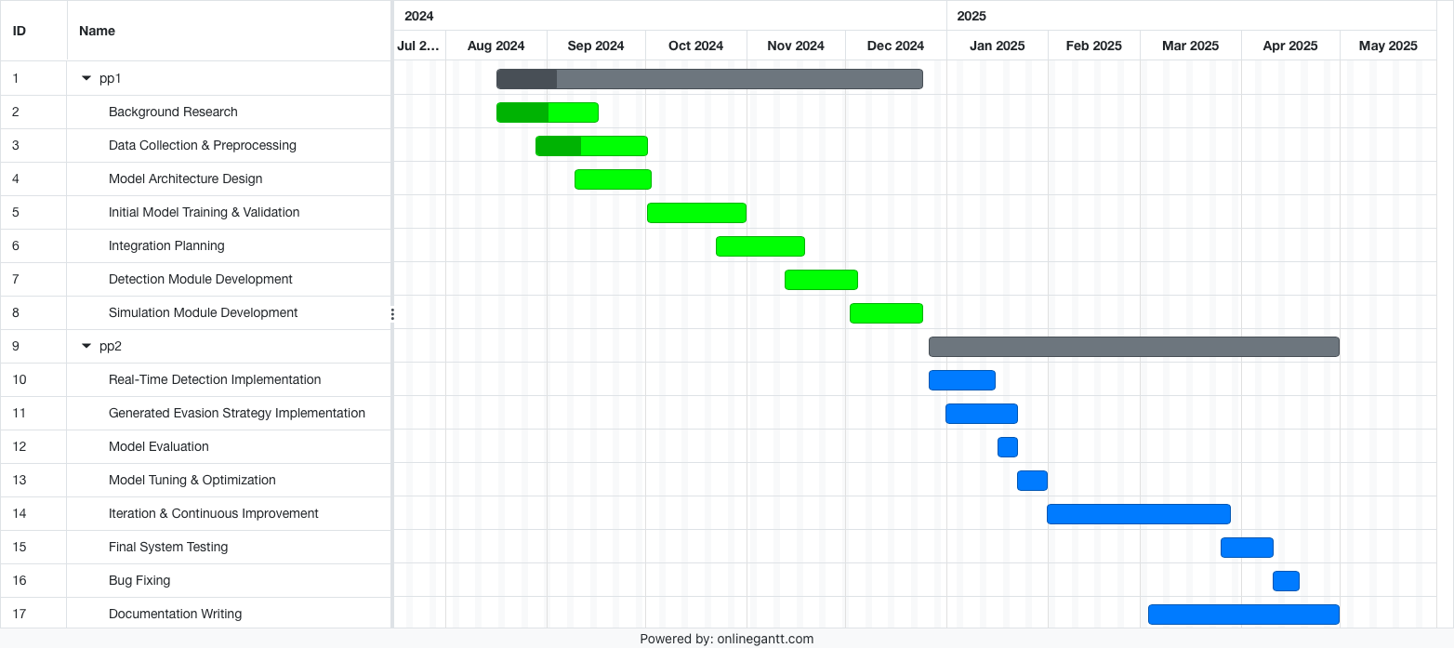
Completion of the project
IT21299452 | Dilhara W. M. A. | 24-25J-025
IT21299452 | Dilhara W. M. A. | 24-25J-025
Notes:
And this is a chart of how I estimate the. Time for this project

Slide 41
References
[1] S. Gallagher and M. Picado, “Agent Tesla amps up information stealing attacks,” 02Feb2021.https://news.sophos.com/enus/2021/02/02/agent-tesla-amps-up-informati on-stealing-attacks/.
[2] S. Gallagher and M. Picado, “Agent Tesla amps up information stealing attacks,” 02Feb2021.https://news.sophos.com/enus/2021/02/02/agent-tesla-amps-up-informati on-stealing-attacks/.
[3] M. Ficco, "Malware Analysis by Combining Multiple Detectors and Observation Windows," vol. 71, no. 6, pp. 1276-1290, 1 June 2022, doi: 10.1109/TC.2021.3082002.
[4] P. A. Selvaraj, M. Jagadeesan, T. M. Saravanan, A. Kumar, A. Kumar and M. K. Singh, "Comparative Study of Detection and Analysis of Different Malware with the Help of Different Algorithm," 2023 International Conference on Computer Communication and Informatics (ICCCI), Coimbatore, India, 2023, pp. 1-6, doi: 10.1109/ICCCI56745.2023.10128452.
[5] B. Jin, J. Choi, J. B. Hong and H. Kim, "On the Effectiveness of Perturbations in Generating Evasive Malware Variants," in IEEE Access, vol. 11, pp. 31062-31074, 2023, doi: 10.1109/ACCESS.2023.3262265.
IT21299452 | Dilhara W. M. A. | 24-25J-025
Notes:
The references listed here provide the foundation for the project’

Slide 42

IT21300950 | VITHANAGE V. K. M.
Cyber Security
IT21300950 | VITHANAGE V. K. M. | 24-25J-025

Slide 43
A Reinforcement Learning agent to dynamically modify the behaviour of a sandbox based on specific malware samples
Modern malware employ variuos evasion strategies to hide their behaviour when inside a sandbox environment
To detect malware in a sandbox environement, only reactive approaches have been applied
The need of proactive approaches similar to adaptive sandbox environment is present in the industry
IT21300950 | VITHANAGE V. K. M. | 24-25J-025

Slide 44
Research Question
How can sandbox environments be designed to dynamically modify their behaviour in response to the characteristics of specific malware samples with aid of an RL agent?
IT21300950 | VITHANAGE V. K. M. | 24-25J-025

Slide 45
Methodology of RL Agent
Upload malware to Cuckoo Sandbox
Retrieve the analyzed reports
Reupload same malware
Apply counter-evasion strategies
Allocate rewards or penalties
Repeat the process to train the agent
IT21300950 | VITHANAGE V. K. M. | 24-25J-025

Slide 46
Current Progress
Malware analysis lab setup with installation of Cuckoo
An automated script to analyze malware sequentially from the database.
Retrieve and store reports in JSON format.
Simulate user interactions from the agent as a counter-evasion strategy.
IT21300950 | VITHANAGE V. K. M. | 24-25J-025

Slide 47
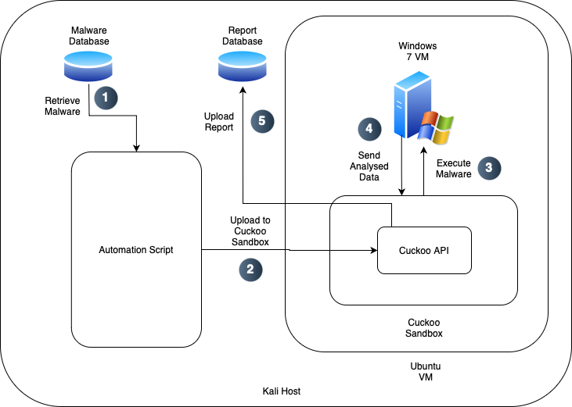
An automated script to analyze malware and report
IT21300950 | VITHANAGE V. K. M. | 24-25J-025

Slide 48
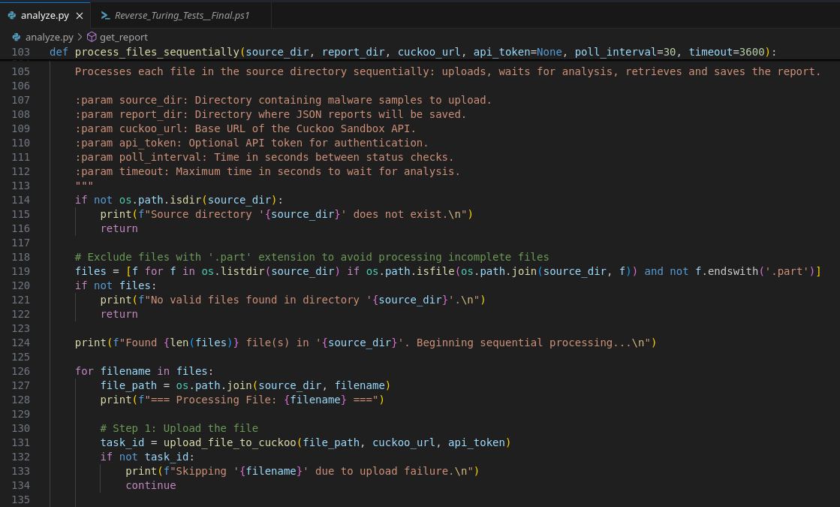
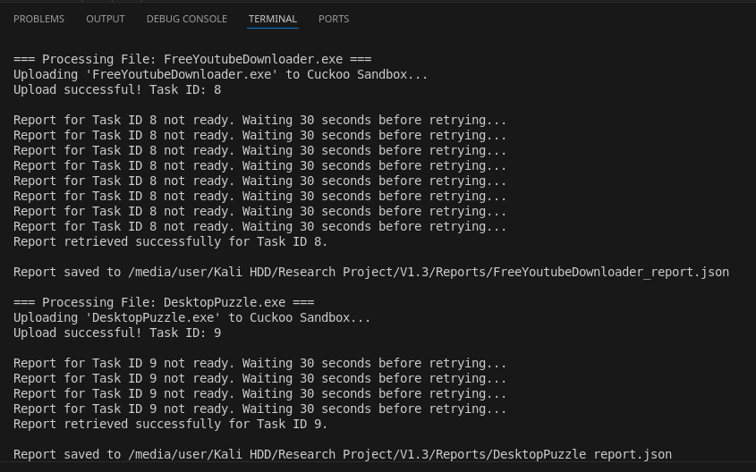
Sequential File Processing
IT21300950 | VITHANAGE V. K. M. | 24-25J-025

Slide 49
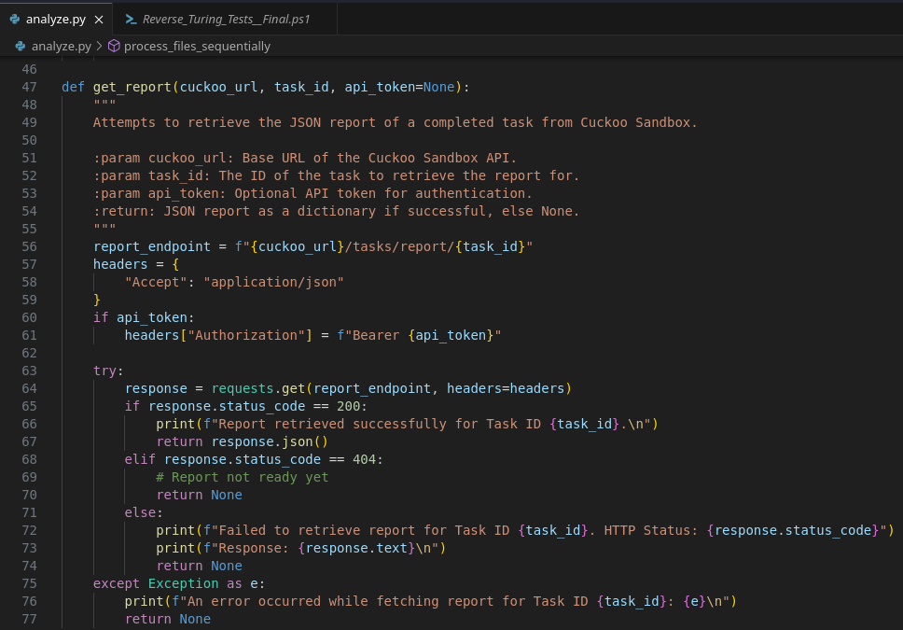
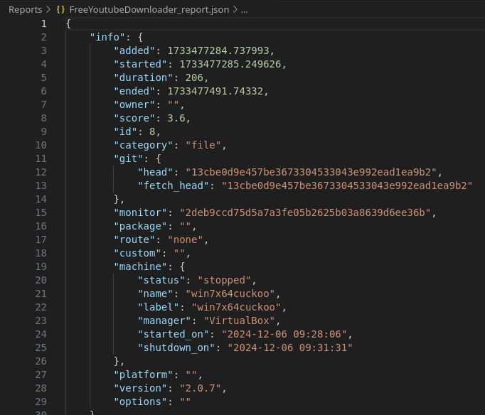
Storing Reports
IT21300950 | VITHANAGE V. K. M. | 24-25J-025

Slide 50
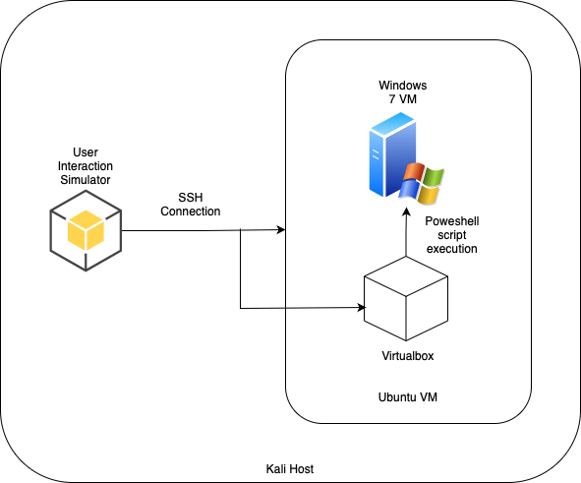
User Interaction Simulator
IT21300950 | VITHANAGE V. K. M. | 24-25J-025

Slide 51
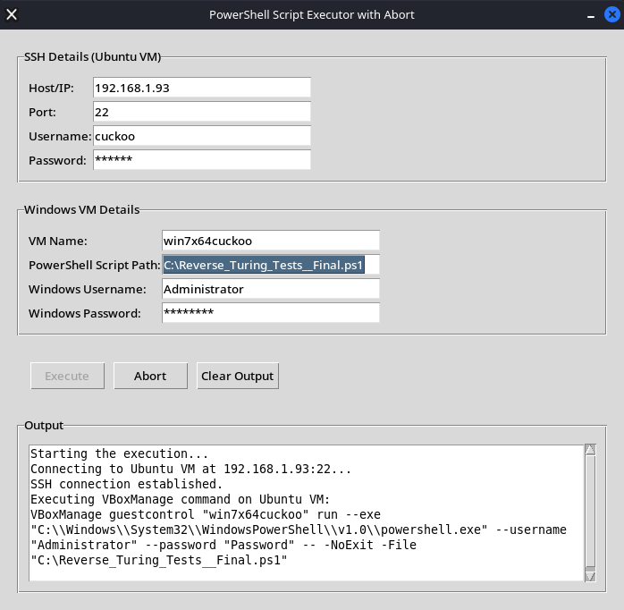
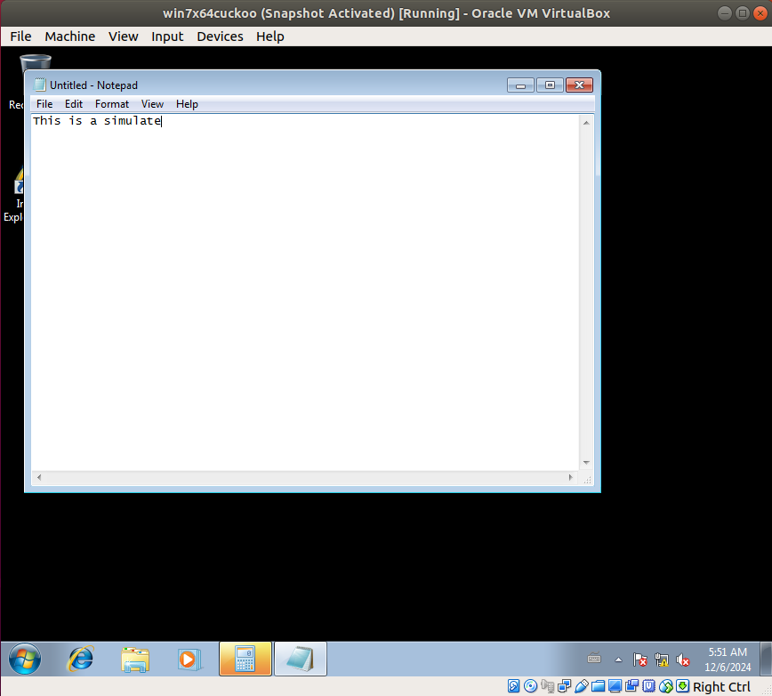
Simulation of user interaction
IT21300950 | VITHANAGE V. K. M. | 24-25J-025

Slide 52
Next Steps
Apply more counter evasion strategies to the agent
Train the RL agent with the integration of dynamic reqard allocation
Integrate group members’ componets
IT21300950 | VITHANAGE V. K. M. | 24-25J-025

Slide 53
References
[1] B. Bokolo, R. Jinad, and Q. Liu, “A Comparison Study to Detect Malware using Deep Learning and Machine learning Techniques,” in 2023 IEEE 6th International Conference on Big Data and Artificial Intelligence (BDAI), IEEE, 2023.
[2] Y. Wu et al., “DroidRL: Feature selection for android malware detection with reinforcement learning,” Comput.Secur., vol. 128, no. 103126, p. 103126, 2023,doi: 10.1016/j.cose.2023.103126.
[3] T. Quertier, B. Marais, S. Morucci, and B. Fournel, “MERLIN -- malware evasion with reinforcementLearnINg,” arXiv[cs.CR], 2022. [Online]. Available: http://arxiv.org/abs/2203.12980
[4] K. Sethi, R. Kumar, L. Sethi, P. Bera, and P. K. Patra, “A novel machine learning based malware detection and classification framework,” in 2019 International Conference on Cyber Security and Protection of Digital Services (Cyber Security), IEEE, 2019.

Slide 54
Thank You!
24-25J-025

